Slide 1
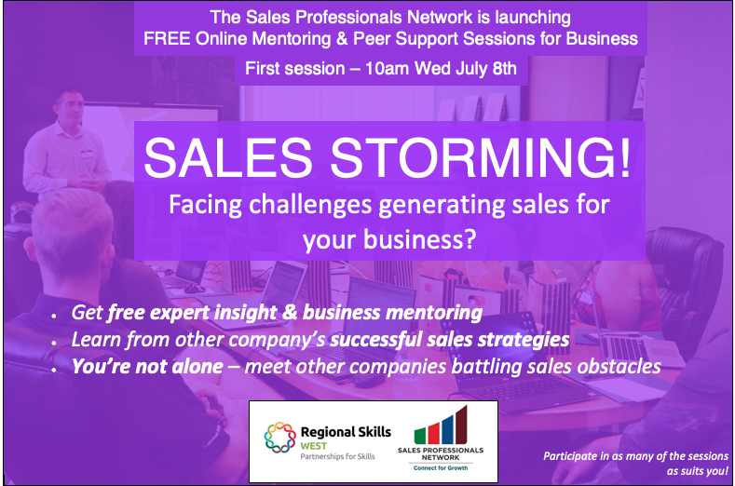

Slide 2
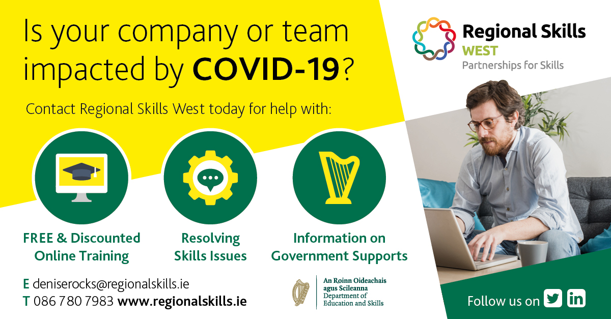




Slide 3




Jonathan Levie, Professor of
Entrepreneurship & Regional Development
Expert in Founder Sales, Scaling Sales, Entrepreneurship
Monica Nielsen, Marketing Lecturer
Expert in Marketing Planning
Darragh O’ Connor, Director of Corporate Sales - Expert in Corporate sales, Hospitality Sales
John McArdle, VP Worldwide Sales
Expert in Inside sales, B2B sales, Tech Sales
Renate Kohlmann, Director
Expert in B2C Service Operations and Sales, Ecommerce Sales
Jamie Ralph, Director
Expert in SME Digital Marketing

Slide 4

Ground Rules
Everything said in the group is confidential. Please do not share with anyone the names or stories you learn in this meeting.
No one is required to speak during the meeting, although we very much welcome you to share your challenges and seek advice.
When a person speaks, please listen actively, with the goal of relating the speaker’s experiences to your own. Please mute your microphone unless speaking. To be called on to speak ask in the chat box or raise your hand.
At times there may be silence during the meeting. This provides a moment to reflect on what has been shared. No one needs to feel anxious or responsible to break the silence.

Slide 5
Sales Storming Session 2
Growing your business using effective marketing communications and sales

Slide 6
Developing Your Marketing Communications Campaign
14-16
Notes:
To that end, more companies today are adopting the concept of integrated marketing communications (IMC). Under this concept, as illustrated in Figure 14.1, the company carefully integrates its many communication channels to deliver a clear, consistent, and compelling message about the organization and its brands.
Integrated marketing communications calls for recognizing all touch points where the customer may encounter content about the company and its brands. Each contact with the brand will deliver a message—whether good, bad, or indifferent. The company’s goal should be to deliver a consistent and positive message at each contact. Integrated marketing communications ties together all of the company’s messages and images. Its television and print ads have the same brand message as its e-mail and personal selling communications, and its PR materials are consistent with web site, online, social media, and mobile marketing content.

Slide 7
D’Arcy Marketing & PR
A Bilingual PR, Communications and Marketing Agency which has inspired clients across the Tourism, TV, Film, Lifestyle, Food, Drinks, SME and Events business sectors for over 22 years.
D’Arcy Marketing & PR has also worked with many of Ireland’s leading Public Sector Bodies
Innovative in it’s ideas, results focused for clients, D’Arcy Marketing & PR delivers strategic, focused and message led, PR for clients across national, regional and local media amongst broadcast, print and digital sectors.
The depth of industry, business knowledge & experience combined with a passionate work ethic to strategically partner it’s clients, D’Arcy Marketing & PR supports clients to grow in their respective markets

Slide 8
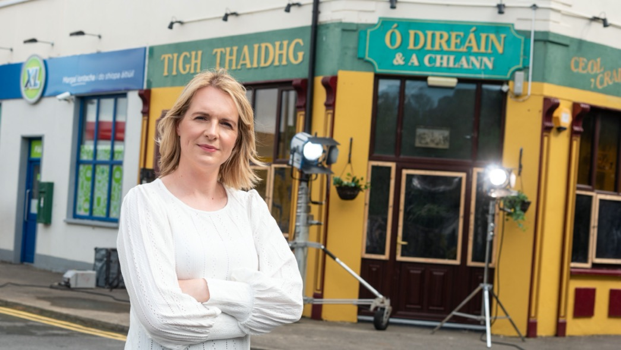
Ros na Rún
TV Watching – Building Profile
Actors Stories
Home Engagement
Book launches
Giving back to the Community – Pieta House – Sunrise Appeal
- Auditioning in a Pandemic

Slide 9
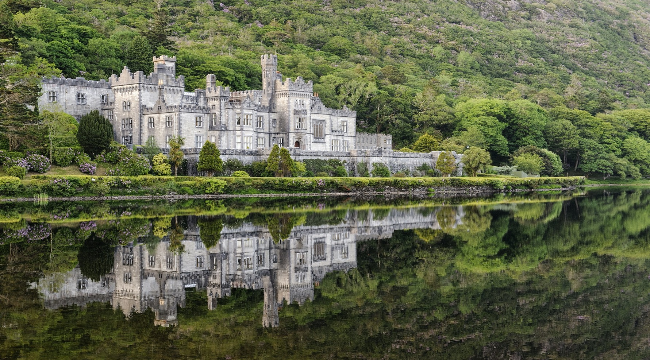

Slide 10
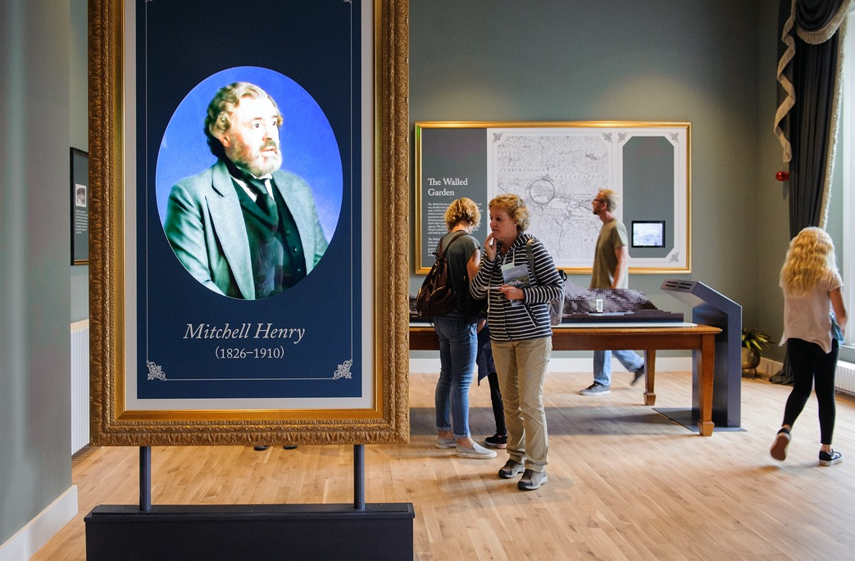
Kylemore Abbey & Victorian Walled Gardens
What is Kylemore Abbey & Victorian Walled Gardens
USP’s
New Investment & Exhibition
Benedictine Community
Gardens
Events – Halloween – Christmas
The People of Kylemore

Slide 11
Kylemore Abbey & Victorian Walled Gardens
https://www.independent.ie/life/travel/travel-talk/its-time-for-tourist-attractions-to-up-their-food-game-38666720.html
https://www.independent.ie/life/travel/the-2020-wander-list-top-20-destinations-and-travel-trends-this-year-38822105.html

Slide 12
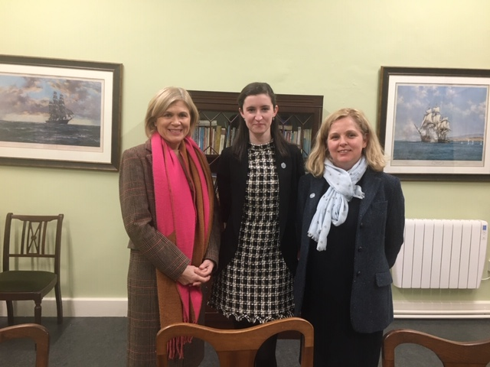
People
Stories
Benedictine Community
Team
Past pupils

Slide 13
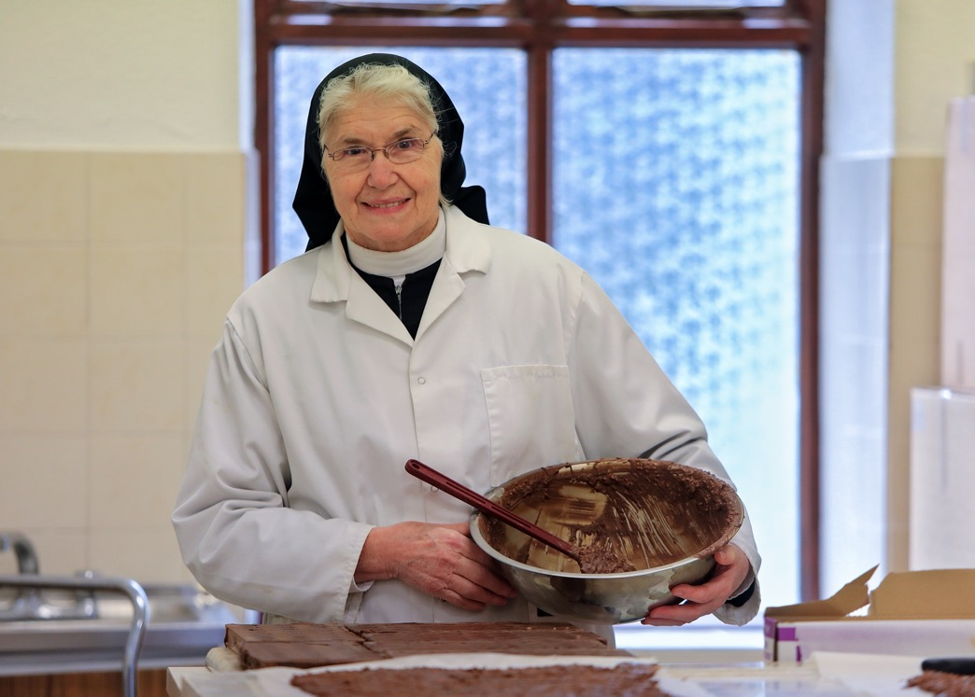
People
Benedictine Community
Prayer
Mindfulness
Products

Slide 14
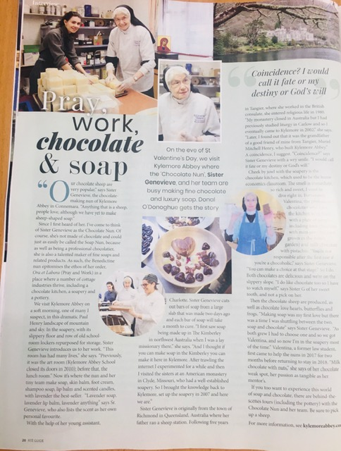
Press Coverage
RTE Guide

Slide 15
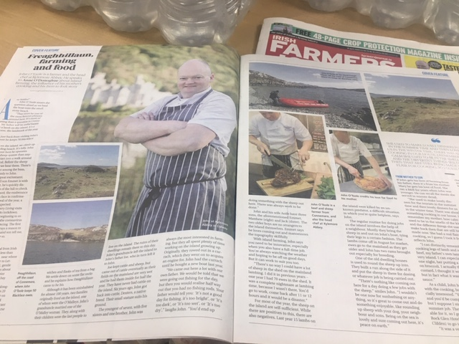
People
The Team
John O Toole
Head Chef
Dexter Farmer Cooks his own produce for Kylemore Visitors

Slide 16
Harvey’s Point
Positioning Trip Advisor Number one Hotel in Ireland Nationally
Reducing the reliance on Northern Ireland Leisure Market
Building recognition for the brand

Slide 17
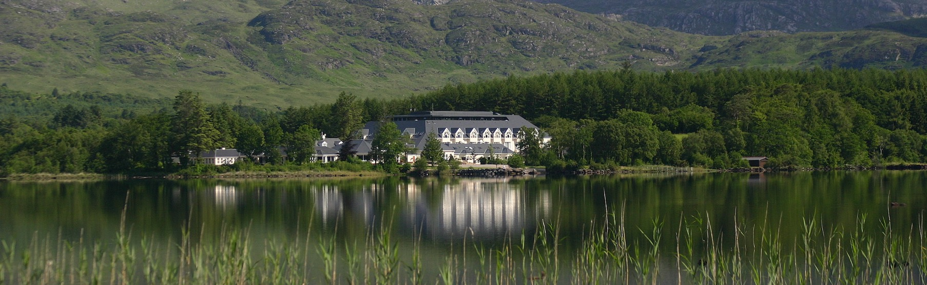
Harvey’s point
Trip Advisor Number 1 Hotel in Ireland

Slide 18
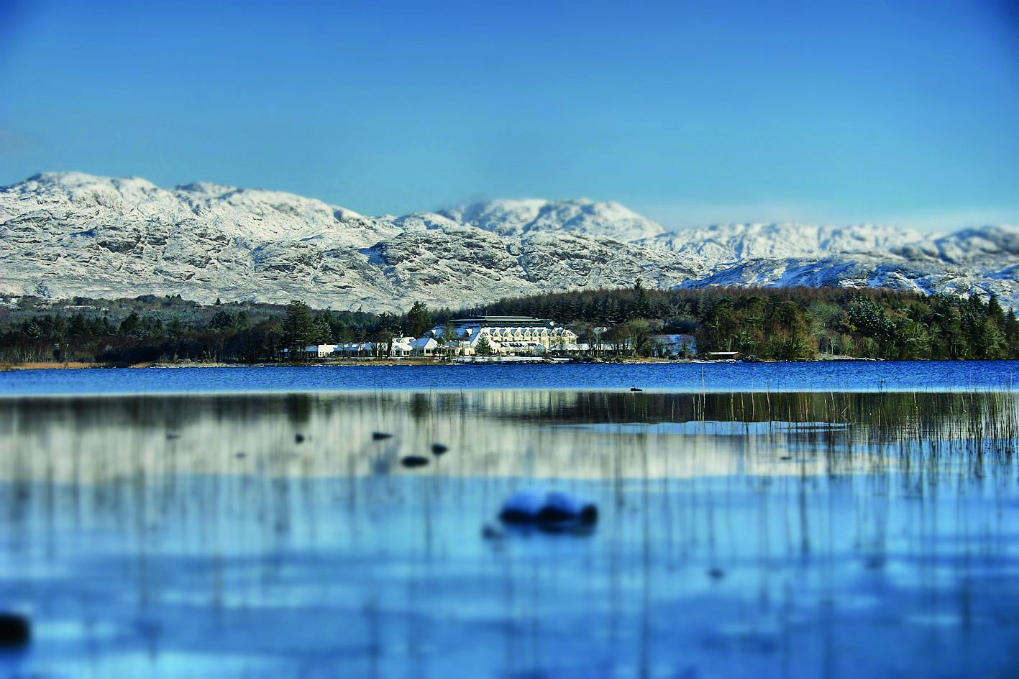

Slide 19
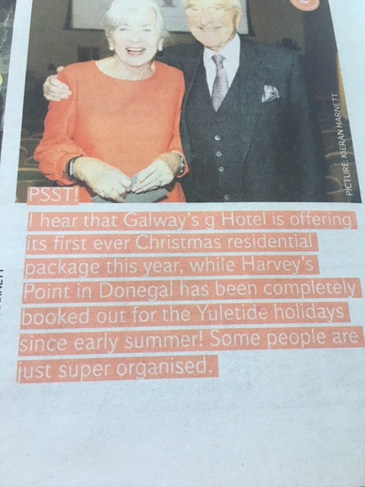
Christmas
Seizing an opportunity when Harvey’s Point was full in July for Christmas 2018

Slide 20
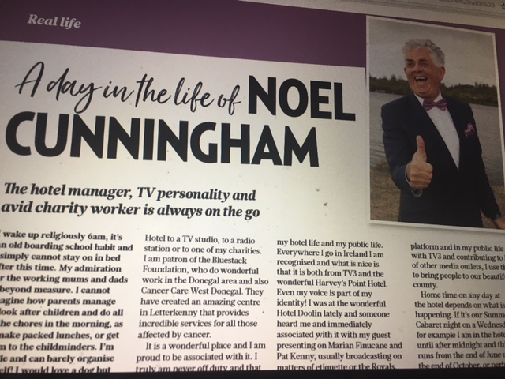
People Assets
Noel Cunningham
Personality
TV Connections
Profile

Slide 21
What is your Story
Delve into your Brands Story
How Relevant is it currently?
How can we make it Relevant?

Slide 22
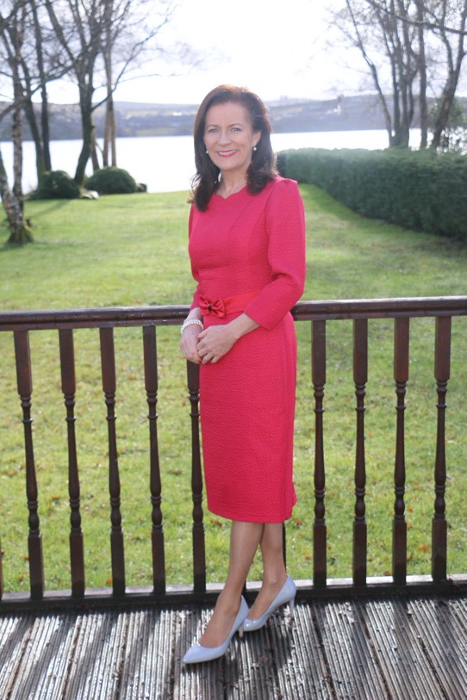
Swiss made in Ireland
Deirdre Mc Glone
Marc Gysling

Slide 23
Ní Neart Go chur Le Chéile
In this together to get out the otherside!

Slide 24
Go raibh Míle Maith Agaibh
Is mór liom bhúr Có-oibriú
Noreen D’ARcy , D’Arcy Marketing & PR
Noreen @darcymarketingandpr.ie www.darcymarketingandpr.ie @noreendarcy @dmpr_galway

Slide 25
Discovery Process…

Slide 26
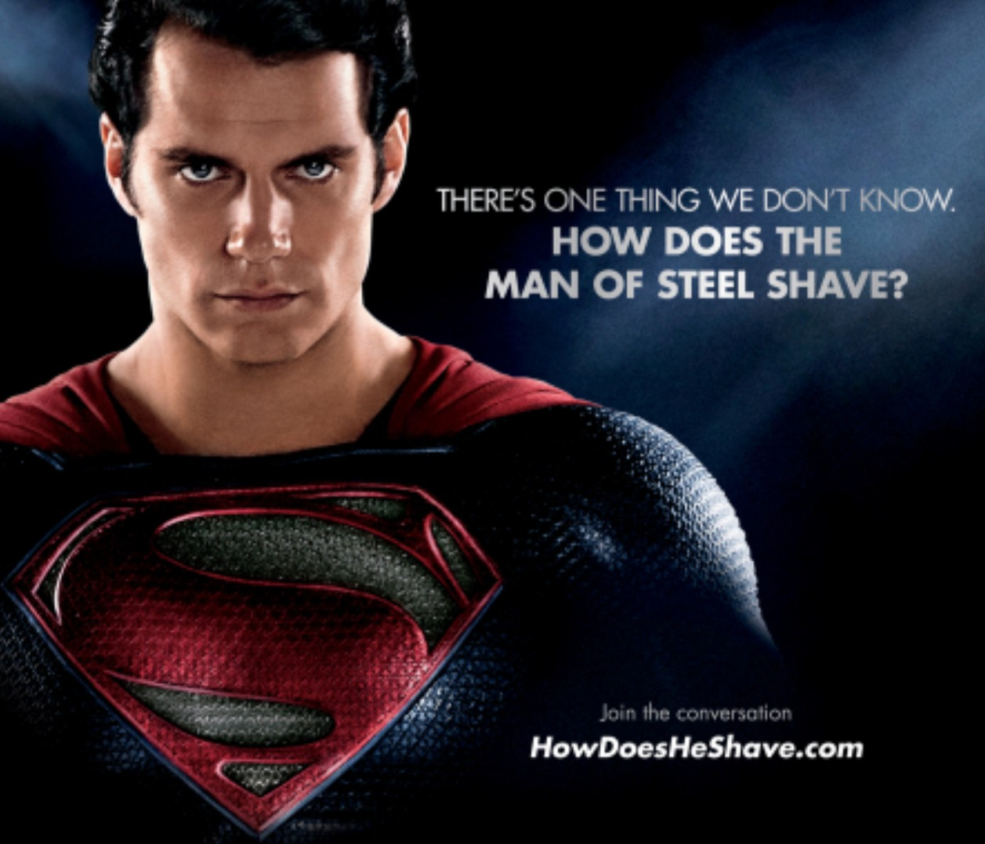


Why?
Manual Time Consuming
Inefficient
Unfair Advantage
€7BN Budget
Current Data Historical Insights Marketing Resources
Advertising Agency Competitive Analysis Latest Software
More Time & Resources

Slide 27

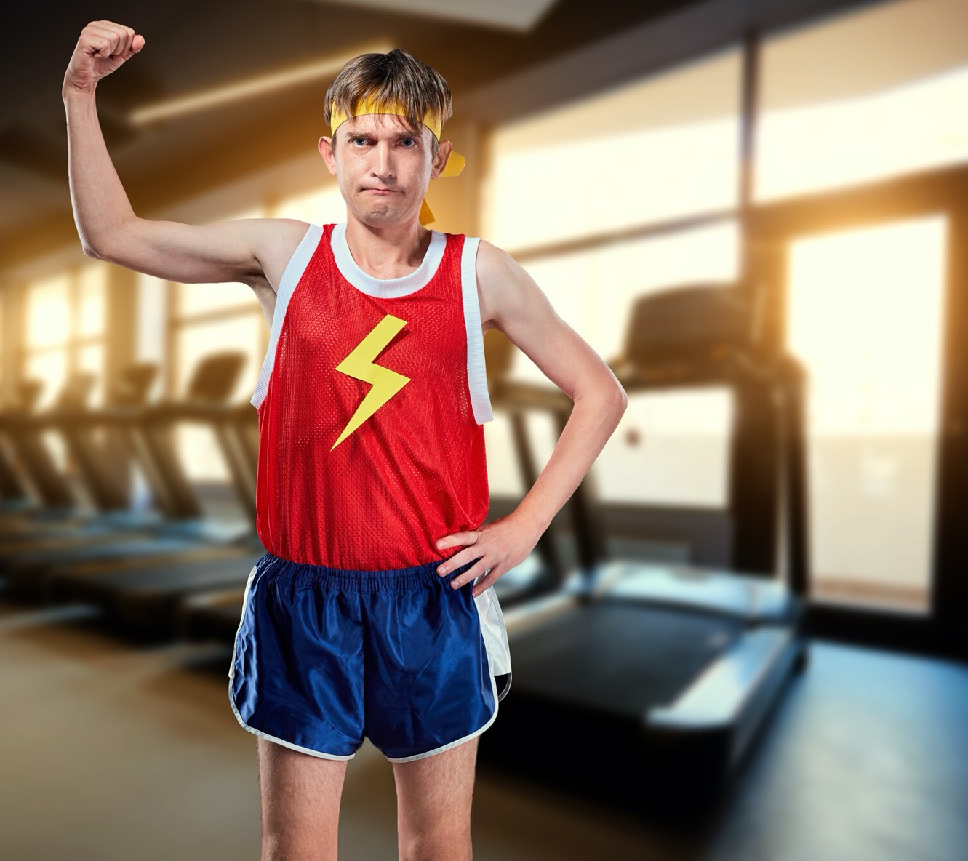


Unfair Disadvantage
Small Budget
Little or No Data Limited Insights
Few Marketing Resources
No Competitive Analysis No Software/Technology Limited Time & Resources

Slide 28

Market Inefficiencies
Advertisers
Media
Silos | Purchasing Process
Manual Time Consuming
No Integration across media

Slide 29
Return
B U Y M E D I A
advertising made easy
Improved

Slide 30


Advertising
Success…
Plan
Purchase
Manage
Learn
Marginal Improvements = Massive Outcomes

Slide 31



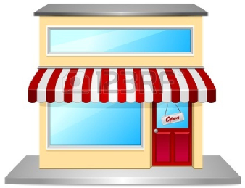



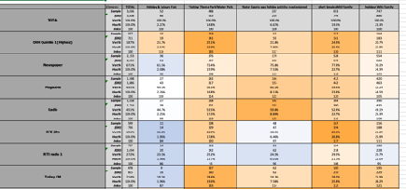


Plan
Media Map
Competition

Slide 32







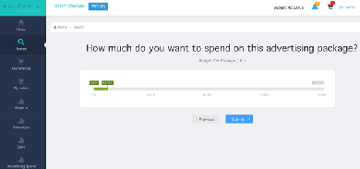
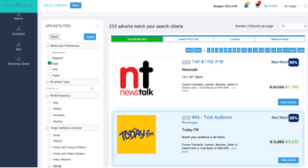
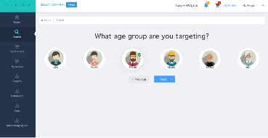

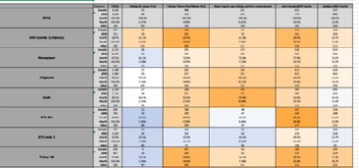
Purchase
Persona Builder
Budget
Results

Slide 33


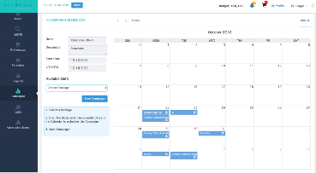
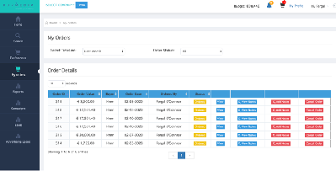
Manage
Reserve
Campaign Schedule
Send Ad Copy
Audited Orders Communications

Slide 34

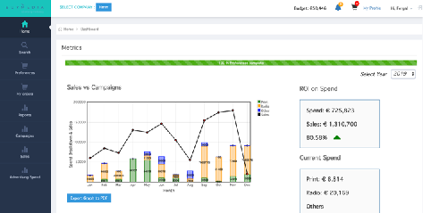
Learn
Monitor
Report
Learn
Feedback Future Advertising

Slide 35



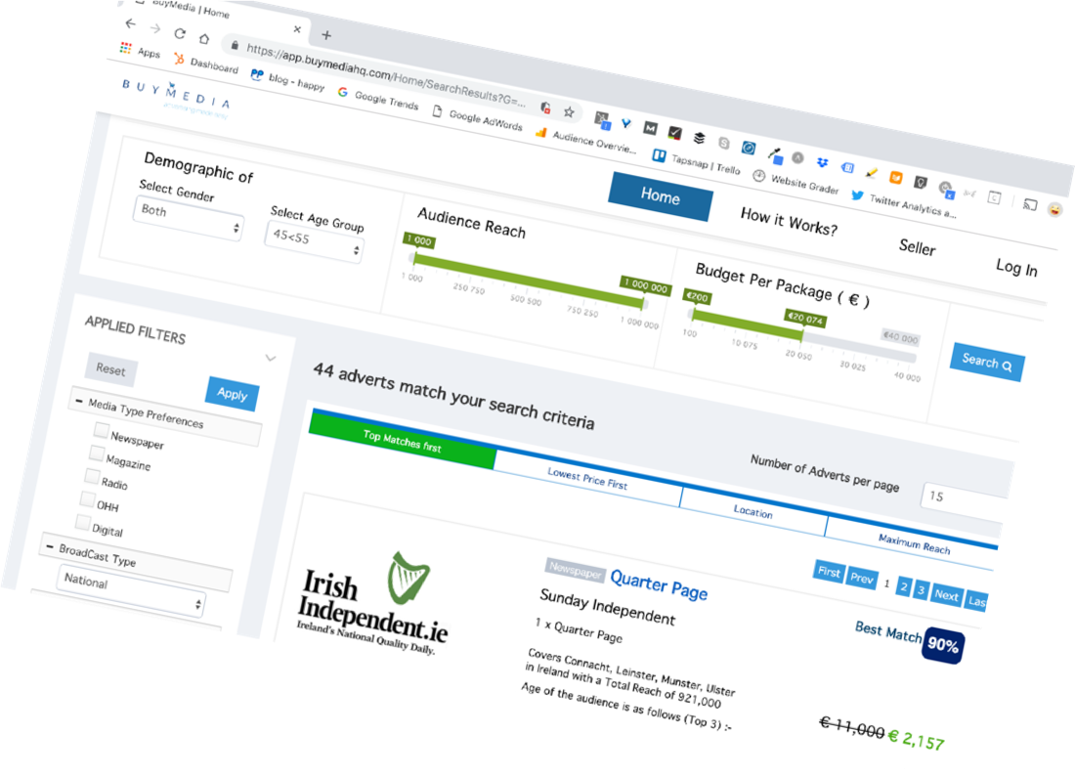
What?
Curated advertising options Competitive Advertising Pricing Streamlined Ad Process
Saving Time & Money

Slide 36




Client Outcomes
8
“Our time spent purchasing advertising has reduced from weeks to minutes,”
Regina O’Donoghue, Sales Manager, Ashford Castle
“Using Buymedia to acquire and schedule all our advertising in Ireland & the UK has lead to a significant uplift in sales & orders,”
Phil Donnelly, Brand Manager, Tipperary Crystal
“Using Buymedia to plan and buy an 8 week campaign for De Facto Shaving OIl gave us greater sales in the 8 weeks, than all of 2018 ” Tom Murphy, Managing Director, Pamex

Slide 37



Silos | Purchasing Process
No Automation Long Lead Time Offline
No Integration across media

Slide 38

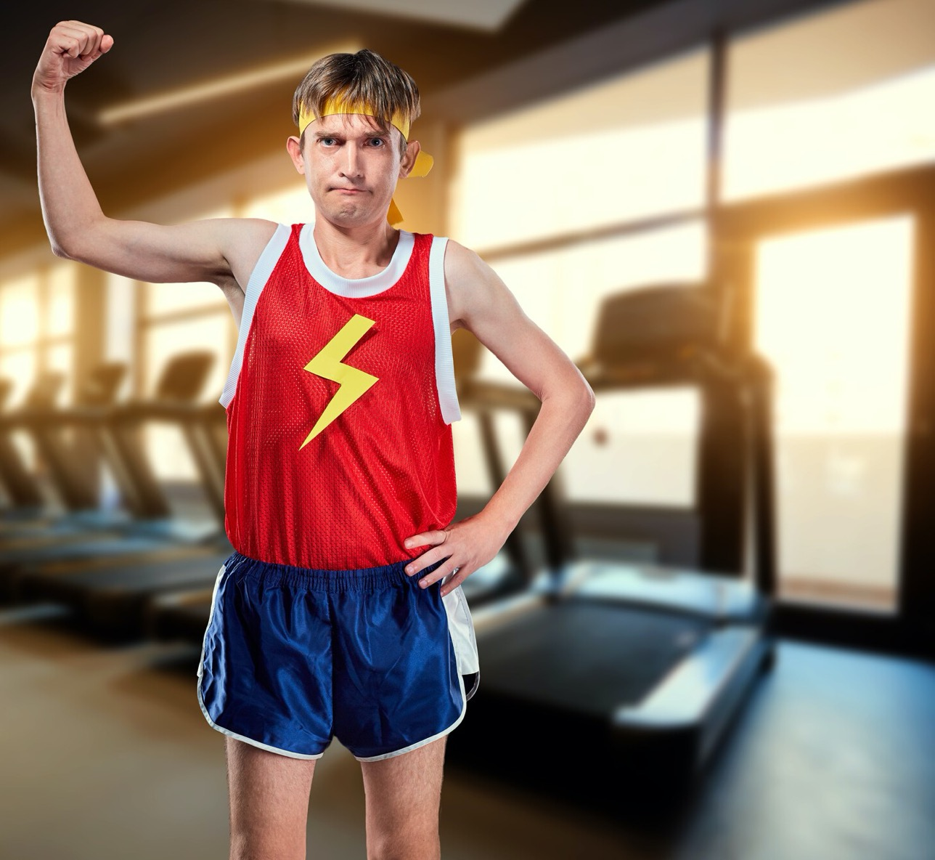


Unfair Advantage
Fergal O’Connor
fergal@buymediahq.com buymediahq.com
+353 87 2450064
+353 1 4433112

