Slide 1
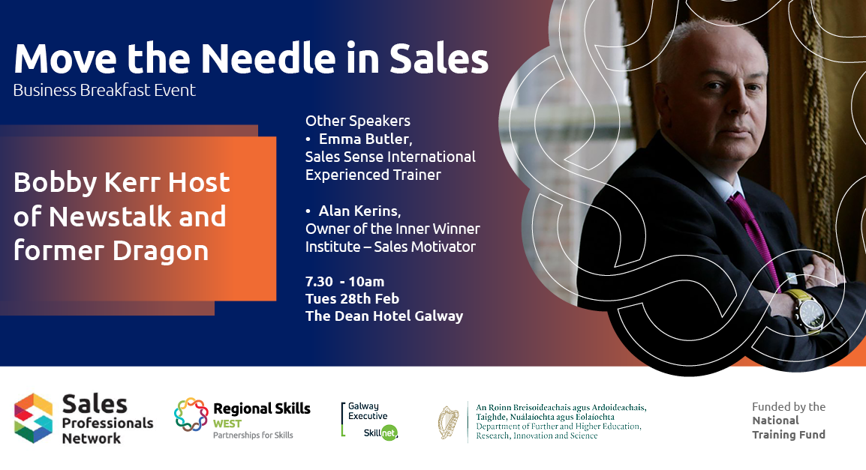


Regional Skills
Denise Rocks– Regional Skills West Manager

Slide 2

Sales Professionals Network
Brought to you by Regional Skills West
A space for those working in sales or marketing in the West to connect and build sales expertise
Also to inform the development of future courses in sales
Build a coordinated approach to sales team talent development between industry and third level education and training providers, as well as between sales and marketing teams

Slide 3
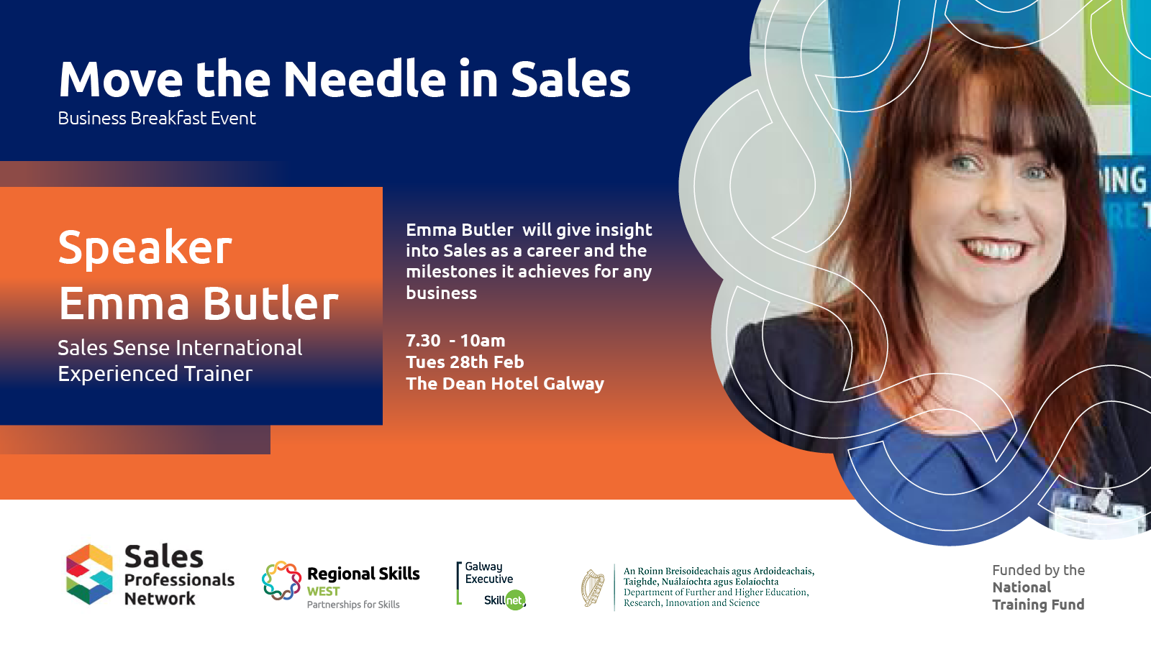
Emma Butler

Slide 4
Agenda
How it all started
Building a simple structure
Daily habits
Questions
Notes:
1 min – Brief intro

Slide 5
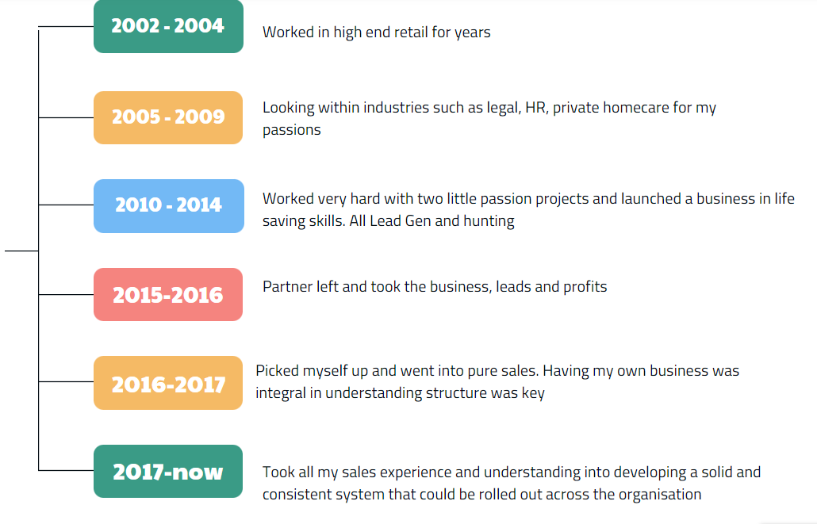
My Journey
Notes:
5 mins – about me and my journey. Focus on pure Sales pieces, how I learned a structure from when I worked for myself at my own business to coming into an industry I had no experience on. The pitfalls of being “product focused” rather than “customer needs” focused and how understanding what I did everyday had impact

Slide 6






Who are we?
SalesSense are Irelands’ fastest growing provider of acquisition sales and award-winning services.
We provide businesses access to professional, productive and passionate teams.
Our founder, Ger Teahon started as “feet on the street” in field sales and learned quickly what made “sense” in Sales!
We realised that services was an integral part of what made sales successful, and this became a very important part of what we offer
SalesSense can name some of Irelands best known companies as their Partners
Notes:
2 mins – A little about SS, why Saas is integral to what we do and why we can work with so many different clients (omni channel experience/understanding data capture and how to enrich clients)

Slide 7

Simple Structure
I always start a sales process with a KISS
Keep It So Simple
Who are my customers?
What do they want?
How do I give it to them?
Do I have a beginning, middle and end?
Notes:
5-7 mins Added this in for a little bit of fun! Scale it right back to have a basic structure. Here I will talk about understanding different industries and their needs. Who or what do they have at the moment? Where can value be added (specifically focusing on how to fill in the gaps – asking and being asked questions and peeling the layers)
Salespeople need to understand the information they provide should be relevant to the customer needs/organisation and industry. This includes inbound/outbound/phone and face-to-face sales. The customer journey very rarely changes! Think before you pick up the phone/cold call! What’s in it for them/What’s in it for me?
When I leave this person, what will we both have gained from the interaction?
Having a clear plan for the interaction benefits both parties from going around in circles.

Slide 8
Simple Sales
Beginning
Who am I?
What do I want?
Middle
Who are they?
What do they need/ want?
End
Do the benefits tie in with their needs/wants now?
Did I ask for the sale?
Am I asking the right questions?
How do I get early interest?
Did I address any issues?
Notes:
5-7 minutes Here I will focus on breaking the sales process up into smaller, more digestible steps. How can you measure success if you don’t have a beginning, middle and end? Drilling down on questioning techniques and using gaining an early hook of interest (industry focus – why am I talking to you today?) and using a mix of open, probing and closed questions within a conversation

Slide 9
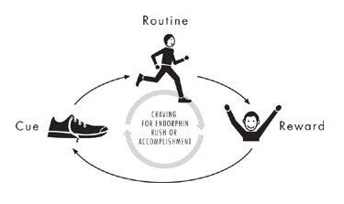
Daily Habits
Routine
Reward
Cue
Doing the same good thing, every day
Lead generation – cold calls/phone calls/follow ups
Presenting – showing, not telling
Closing – Controlling the next stage
Understand my own Law Of Averages
Recognise Rewards!
Notes:
3 mins Consistency is key to any structure! How many times have new years resolutions failed or, Lenten vows to give up chocolate! Why? Because the will, the want and the integrated reward wasn’t there early on

Slide 10

Notes:
2-5 mins

Slide 11

Regional Skills West
An initiative of the Department of Further & Higher Education, Research, Innovation & Science
What can we do for your business?
Conduct a Free Skill Needs Analysis
Provide a free customised training options report
Advise on funding for training
Connect you to the right people
Help develop new training programmes to respond to specific skills gaps

Slide 12
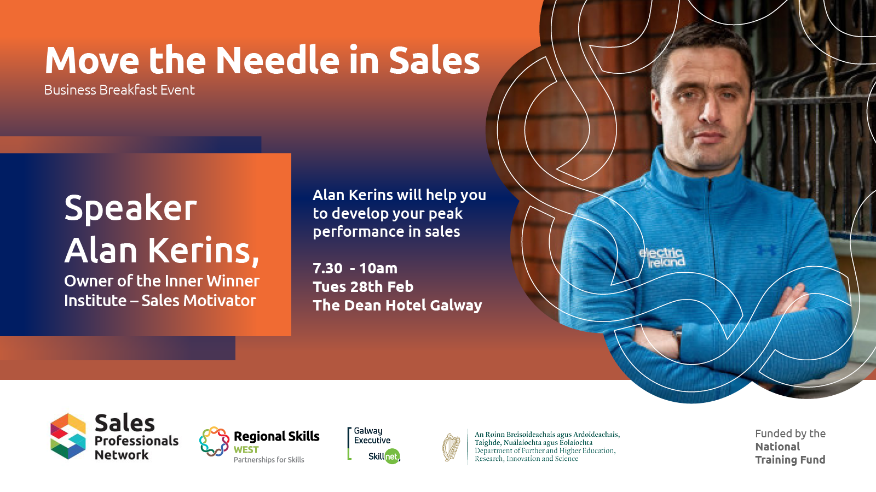
Q & A Session

Slide 13


EVERY CONTACT COUNTS!!!!

Slide 14
EVERY TIME WE MET/SPEAK TO SOMEONE
WE CREATE A REACTION
POSITIVE OR NEGATIVE

Slide 15
50%

Slide 16
EVERY TIME WE MET/SPEAK TO SOMEONE
OPPORTUNITY & ABILITY TO
PERSUADE & INFLUENCE OTHERS

Slide 17
WHATS IS LIKE TO EXPERIENCE YOU?

Slide 18
WHATS IT LIKE TO BE ON THE OTHER END OF YOU?

Slide 19
WHAT WOULD YOU LIKE THEM TO EXPERIENCE!

Slide 20
SLEEPWALKING
WITHOUT RESET
!!!!

Slide 21
WHAT WOULD YOU LIKE THEM TO FEEL!

Slide 22
THEY CARED ABOUT YOU!!!

Slide 23
CARE MORE ABOUT THE PERSON THAN THE SALE

Slide 24
PEOPLE BUY YOU
EMOTION
NEW
MEMORABLE

Slide 25
Makes you an immediate Sales Expert
AUTHENTICITY
DISCOVERY
(LISTEN)
ENGAGEMENT
A dynamic within a relationship which holds attention, heightens interest and motivates action!
You can communicate more through questions

Slide 26
AUDIENCE IMPACT
WORDS
7%
PHYSICAL & TONE
93%

Slide 27
AS A SALESPERSON / LEADER
YOU ARE ALWAYS
ON STAGE!!!!

Slide 28
ACTIONS SPEAKS LOUDER THAT YOUR WORDS!

Slide 29
4 E’s
E ENERGY
E EXCITEMENT
E ENTHUSIASM
E EMPATHY

Slide 30
SALES /LEADERSHIP IS A
RELATIONSHIP THROUGH WHICH YOU……. ……..
INFLUENCE THE ACTIONS AND BEHAVIOURS OF OTHERS

Slide 31
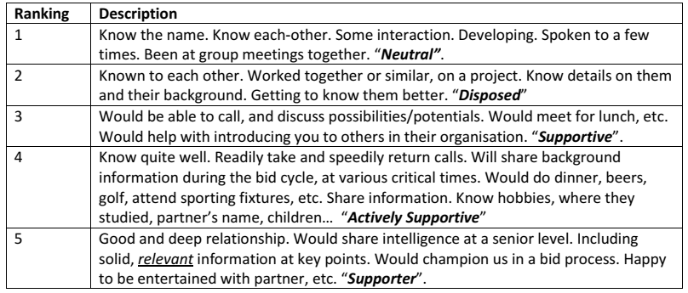
Ranking our Client Relationships
To achieve more consistency, the following guide will help:

Slide 32
UNDERSTAND THE CUSTOMERS PROFILE
BE BRIEF
BE BRILLANT
BE GONE

Slide 33
EXERCISE
WHITE PAPER EXERCISE

Slide 34
THE PROCESS
CHANNELS
ENCODE
DECODE
SENDER
MESSAGE
RECEIVER
TWO WAY FEEDBACK & ENGAGEMENT

Slide 35
ENGAGEMENT
QUESTIONS
SHARE LEARNINGS
REFLECTIONS
ROLE PLAYS /VISUALISATIONS/ WALK THROUGHS
INTERACTIVE EXERCISES/ EXPERIENCES

Slide 36
EXERCISE
SELLING EXERCISE

Slide 37

WHATS IS LIKE TO EXPERIENCE YOU?

Slide 38
EXAMINE
DIAGNOSE
PRESCRIBE

Slide 39
IT’S ALL ABOUT THE AUDIENCE
IT’S NOT ABOUT YOU

Slide 40

Questions Direct Focus
Questions direct focus
Questions facilitate alignment

Slide 41
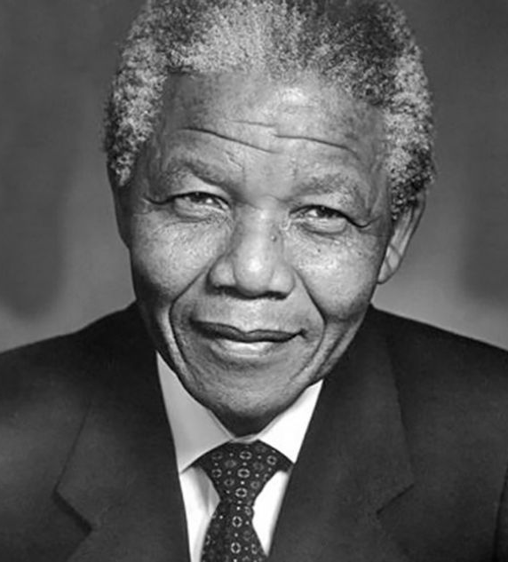
HOW SHOULD I BE?

Slide 42
SALES MANAGERS
SALES PEOPLE

Slide 43

71%
One Team
Notes:
The role of the director is to create the space where the actor or the actress can become more than they’ve ever been before, more than they’ve ever dreamed of being.

Slide 44
765%Cohesive
Connected
Cooperative
Collaborative
Cooperative, Collaborative
Cohesive, Connected
765%
Net Worth
“That Feeling”
10 Companies Over 10 Years
5 Average 5 Cohesive, Connected, Cooperative, Collaborative
That Feeling
Notes:
The role of the director is to create the space where the actor or the actress can become more than they’ve ever been before, more than they’ve ever dreamed of being.

Slide 45

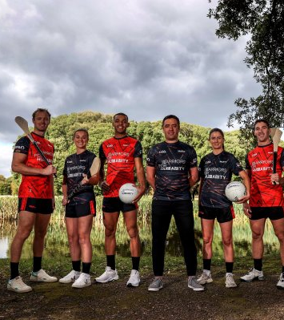

Slide 46
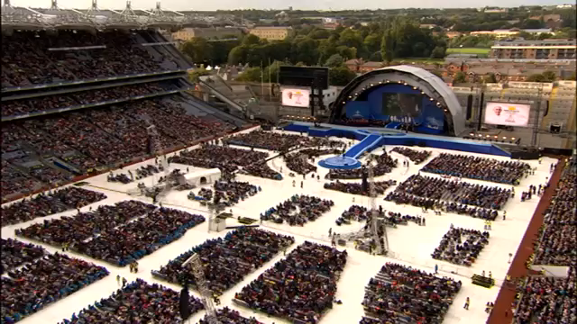

Slide 47
TEMPLATE
WHY
BENEFIT
HURT
WHAT
WHY
BENEFIT
HURT
WHY
BENEFIT
HURT

Slide 48

Galway Executive Skillnet
Providing quality training to give you relevant skills at a time, place and price that works for you
A multi-sector learning network which provides subsidised training for over 400 local businesses
We are committed to supporting regional growth and workforce development through the provision of quality, industry-led training
Reach out today to info@galwayexecutiveskillnet.ie

Slide 49
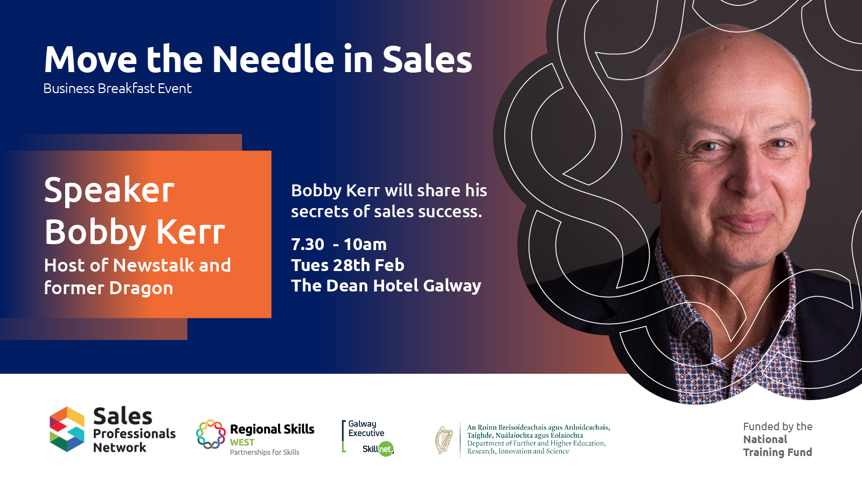
Q & A Session

Slide 50
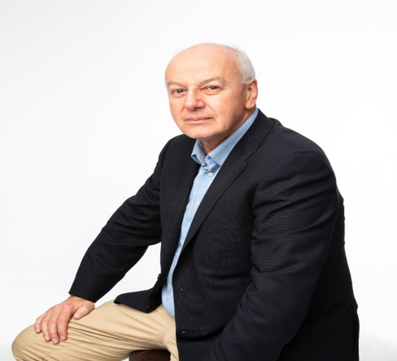

Moving the needle in Sales
Bobby Kerr – Galway February 2022

Slide 51
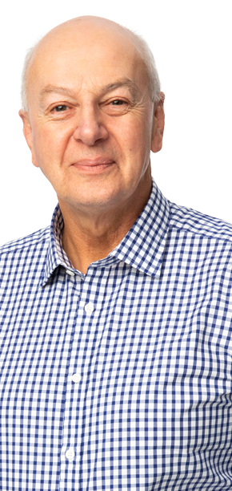




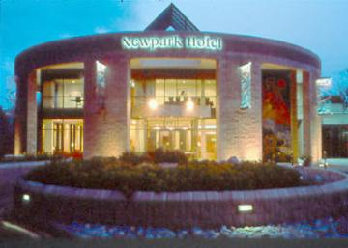

Bobby Kerr

Slide 52

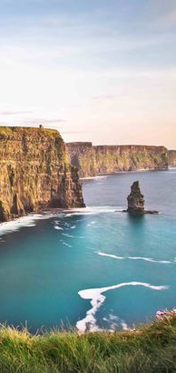
Cliffs of Moher
Chairman since September 2018
One of Irelands busiest visitor attractions
UNESCO world heritage site
Ambitious development plans for the site
Real challenges post Covid-19
Development of the coastal walk (11K). Hag’s Head to Doolin - our very own Camino!

Slide 53

Great Lighthouse of Ireland
Chairman since 2016
18 properties on the Island of Ireland
Supported by and affiliated to Commissioners of Irish Lights
Essentially a marketing collective of historic maritime locations
Different Lighthouses – different visitor experience
Heritage tourism and unique accommodation

Slide 54

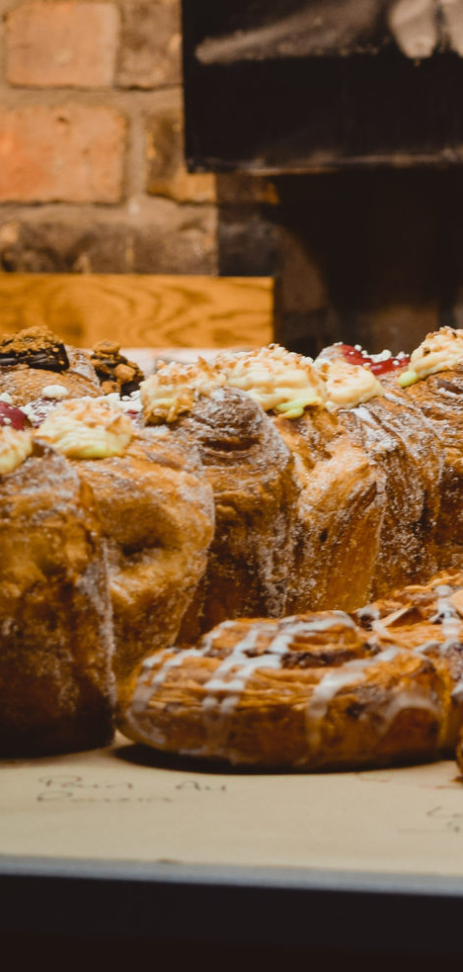

Dropchef & Bread 41
Dropchef – healthy food delivery business
Joined the board in 2019
Nonexecutive director
Bread41 – Bakery Pearse street
A fantastic artisan bakery making sour dough breads and confectionary
Helping the founders and management team grow and scale the business

Slide 55
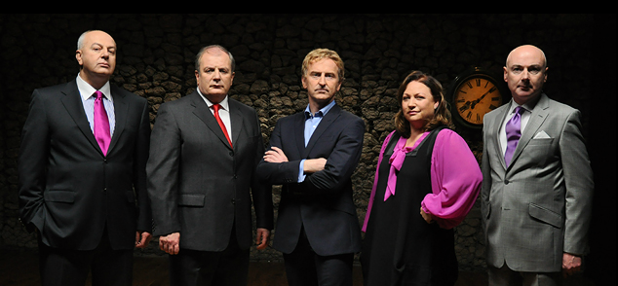

All the Dragons
One of the founding dragon’s: 2008-2012
9 investments
Investment Portfolio = the good, the bad, the ugly and the very ugly

Slide 56
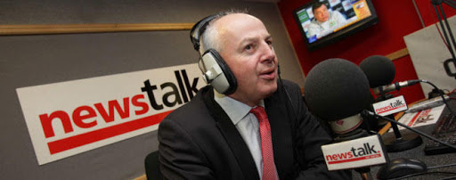

Broadcaster 2010 – to date
2010 – 25,000 listeners
2022 – 120,000 listeners
Business for everybody
No stocks, shares or debt equity ratios!
The show that gets behind how things really work in Irish business
Down to Business
with Bobby Kerr

Slide 57

Key Facts: Perk / Insomnia 1998-2018
Ireland’s leading coffee company
17 million cups of coffee sold annually
145 Shops and 400 convenience stores
€45 Million Turnover
Over 500 Staff
First Irish Company to go 100% Fairtrade and organic
All our coffee - roast to order
Partnership with BWG foods(Spar & Mace), over 500 units. Primark, Eason's & Meadows & Byrne -12 Units.
Insomnia coffee available in almost 600 locations

Slide 58


Consistency & Personalisation:
Know Your Customer

Slide 59
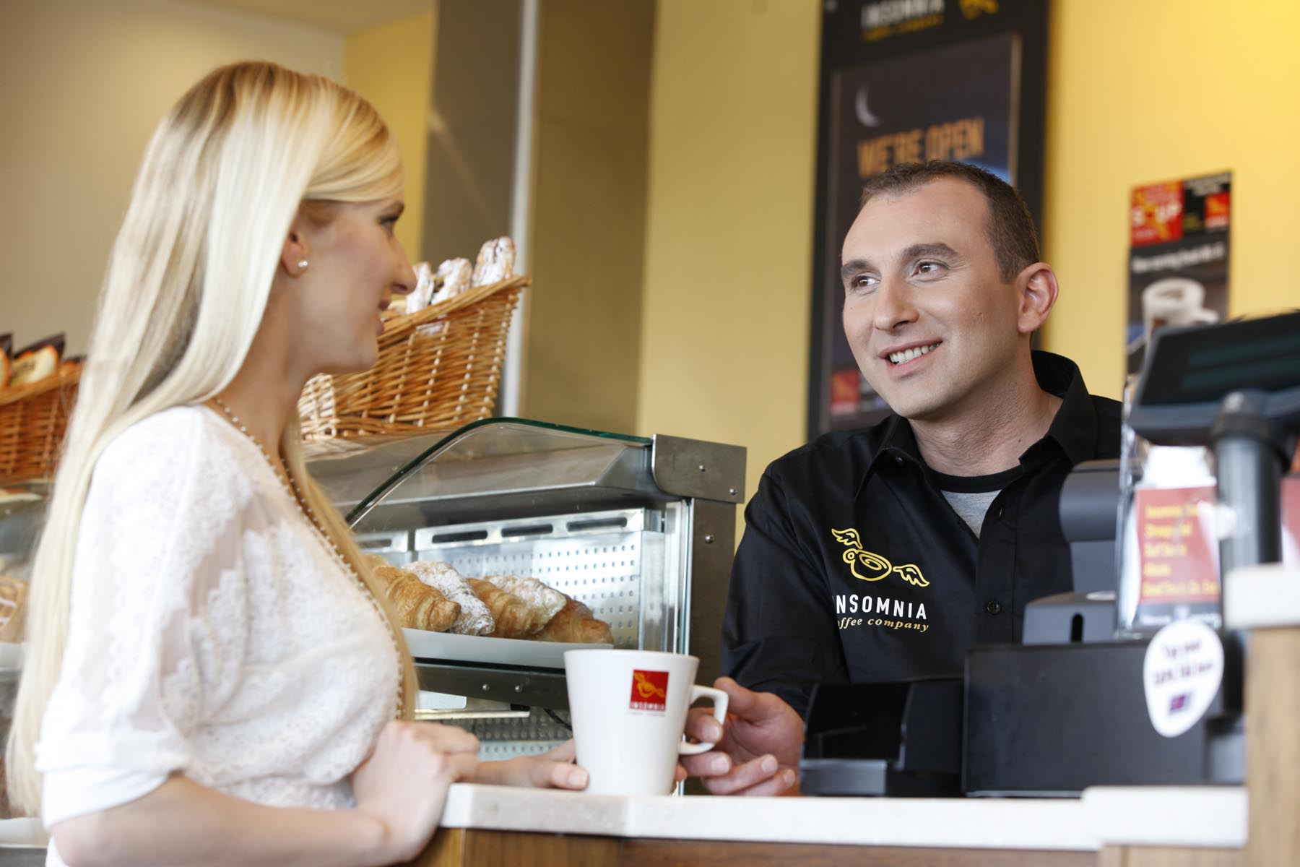
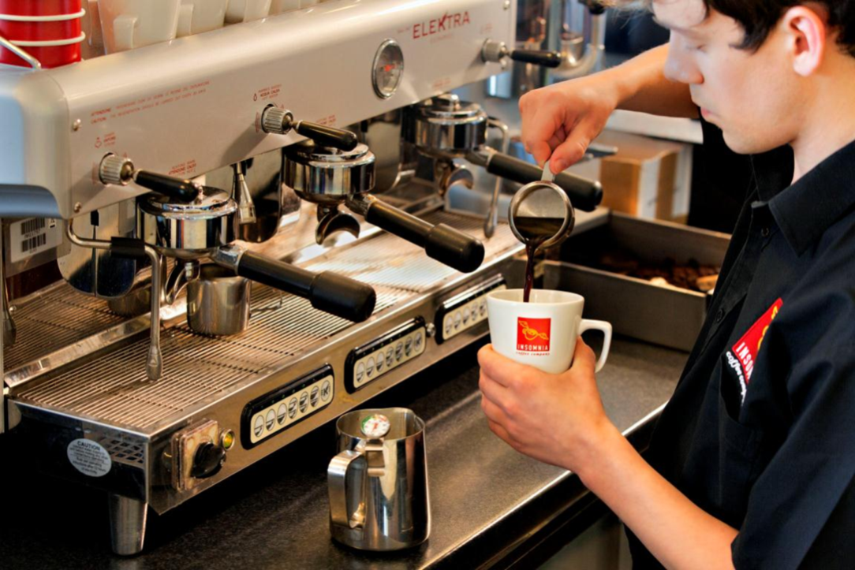
Front Line Staff: Know Your Product

Slide 60

Branding
Image
Expectation
Consistency
Mistakes Made
Lessons learned

Slide 61
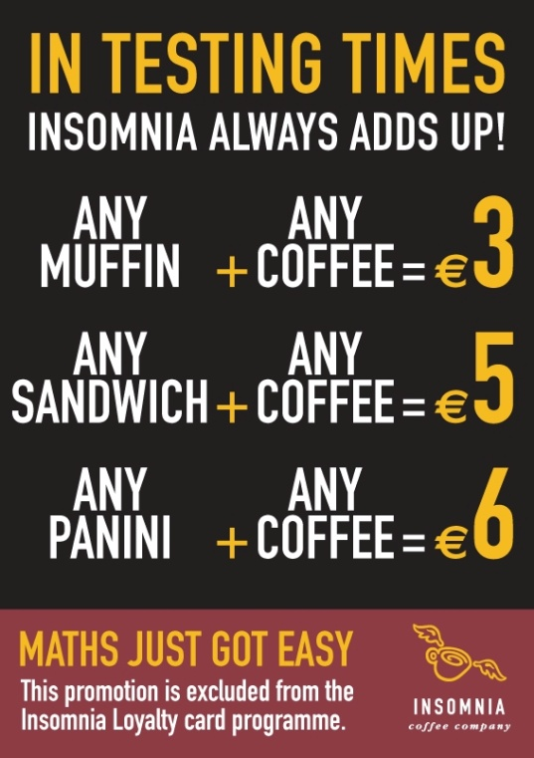


Reminder: Winning in Tough Times (2008 slide)
Lower your costs and be competitive
Offer Value
Reward loyalty
Scrutinise cash flow
Be flexible
Communicate – internally and externally

Slide 62


Moving The Needle in Sales
Energy & Enthusiasm
Product knowledge
Listening
Offering a solution
Likeability
Following up

Slide 63
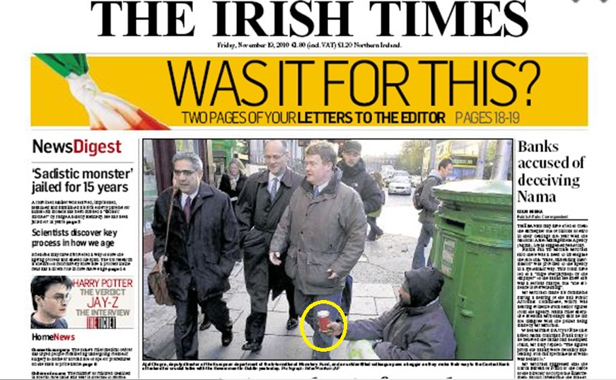

The Best Marketing is FREE

Slide 64
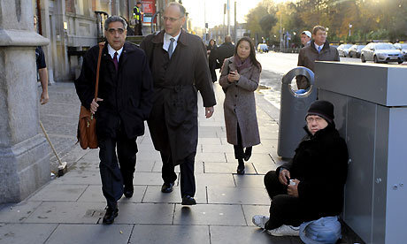
The Best Marketing is FREE

Slide 65
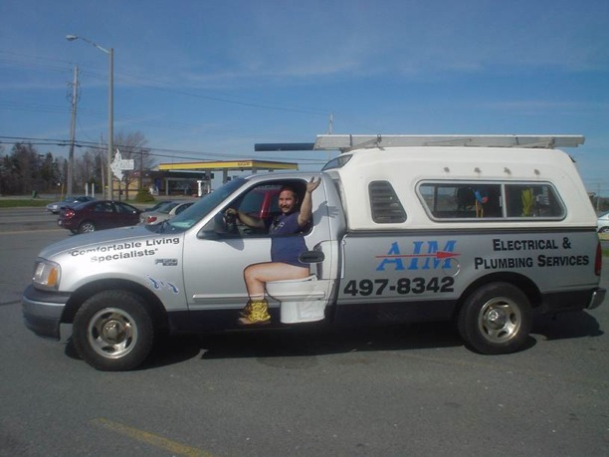
Get Creative- Lead from the front

Slide 66
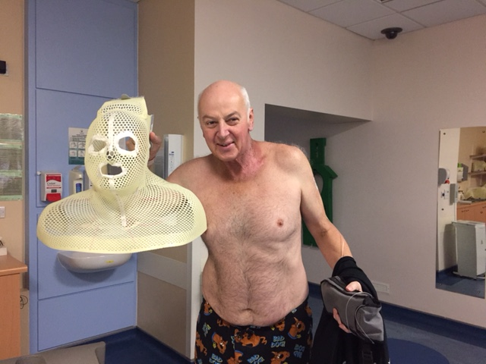
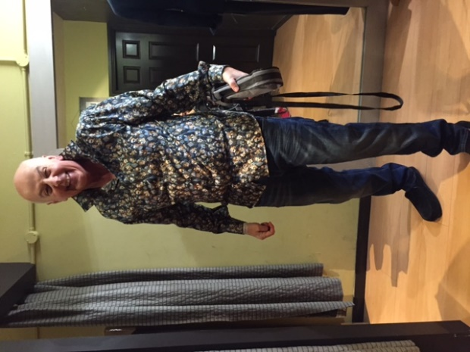
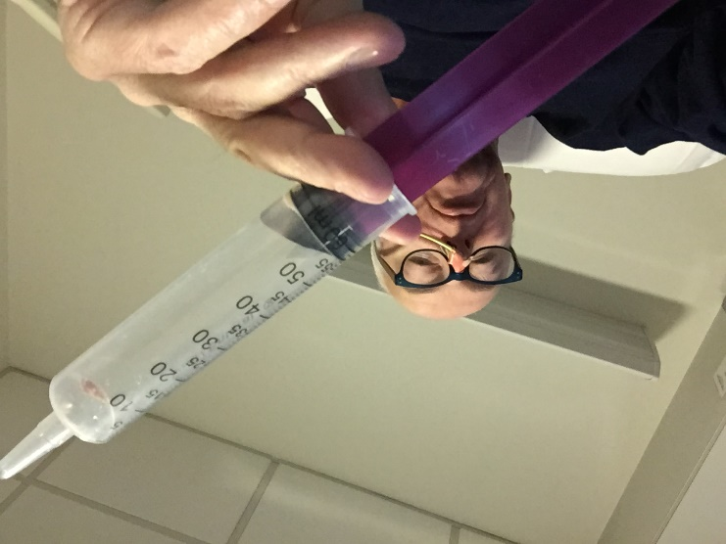
Your Health is Your Wealth
HEALTH
FRIENDS
FAMILY

Slide 67

Link Between Business Health and Personal Health
If you are physically & mentally fit, it shows
Always need to lead by example
Your mind is sharper when you are fit
Exercise helps your mind relax and problem solve
Make your fitness your work

Slide 68
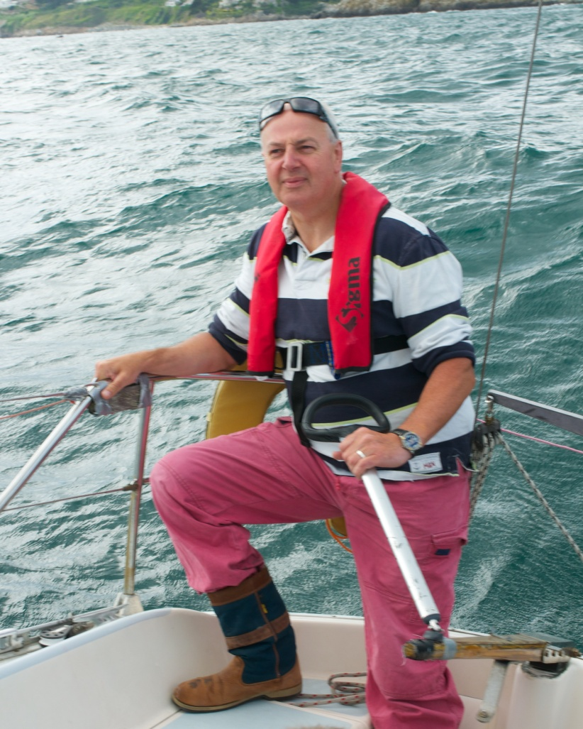
Bobby’s Top 10 Life Tips
Reasons to be cheerful…
Forget the begrudgers
Enjoy what you do
Be thankful you have your health, friends and family
Embrace technology & educate yourself
Surround yourself with positive people
Set realistic goals and targets for yourself
Integrity – don’t do anything you’ll regret
Innovate constantly – there is always a better way
Network – learn from others
Like the Cats – play to win – Damn those Limerick lads!

Slide 69




Questions?
Bobby Kerr 2023

Slide 70




Thanks to our Sponsors !

Slide 71

Save the Date – 17th May 2023
Chanelle Mc Coy
Awarded the All Ireland Business Champion Award 2018 for outstanding achievements in business leadership; was an investor on Dragons’ Den; recently ranked “number 23 in the 50 incredible people shaping modern Ireland.”

Slide 72

Stay Connected!
To join the Sales Professionals Network email: westadmin@regionalskills.ie

Slide 73

