Slide 3
Monica Nielsen & Laura Hegarty
Marketing Lecturers
Experts in Marketing Planning, Digital Media & Marketing , Web Analytics
Jonathan Levie, Professor of
Entrepreneurship & Regional Development
Expert in Founder Sales, Scaling Sales, Entrepreneurship
Darragh O’ Connor, Director of Corporate Sales - Expert in Corporate sales, Hospitality Sales
John McArdle, VP Worldwide Sales
Expert in Inside sales, B2B sales, Tech Sales
Renate Kohlmann, Director
Expert in B2C Service Operations and Sales, Ecommerce Sales
Jamie Ralph, Director
Expert in SME Digital Marketing

Slide 4
Ground Rules
Everything said in the group is confidential. Please do not share with anyone the names or stories you learn in this meeting.
No one is required to speak during the meeting, although we very much welcome you to share your challenges and seek advice.
When a person speaks, please listen actively, with the goal of relating the speaker’s experiences to your own. Please mute your microphone unless speaking. To be called on to speak ask in the chat box or raise your hand.
At times there may be silence during the meeting. This provides a moment to reflect on what has been shared. No one needs to feel anxious or responsible to break the silence.

Slide 5
2. Personas’ Goals
1. Personas
4. Your Solution / Value Prop
Define a few core goals the persona(s) you will be selling to must achieve.
List the key people in your target market you are “selling to”.
It could be a multiple of people (think of buyers versus users).
If you can’t name them, describe them: what have they got in common?
List a few key solution / value proposition offerings that your offering brings to bear.
3. Pain Points
6. Proof Point or
Customer Quote
5. Feature Mapping
List the main pain points that the personas are suffering from today
Try this thought experiment:
If your offering did not exist what pain would the personas suffer from?
How do your offerings (platform, product, or services), capabilities or content map to the desired solution proposition?
How do these map onto the benefits that your customer personas are seeking to take their pain away?
Write down a compelling proof point that your offerings match the benefits sought
OR
a customer quote that can be backed up with evidence or a reference call.

Slide 6
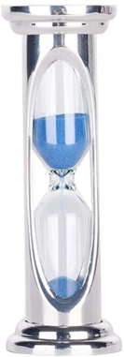
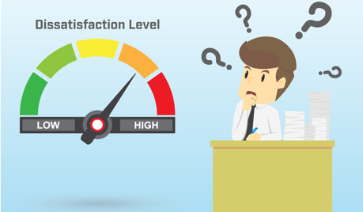
2. Personas’ Goals
1. Personas
4. Your Solution / Value Prop
Generate Leads with their channel partners
ELIMINATES SPREADSHEET SPRAWL
GIVES Channel Marketers the gift of time
Gives Partners Funding based on Performance Outcomes
Channel Marketing
Channel Program builders
3. Pain Points
6. Proof Point or
Customer Quote
5. Feature Mapping
Easy to consume DASHBOARDS
Automated workflows to set up marketing programs
Auto-calculators for Marketing ROI calculation and reporting
Data always backed up and archived
LACK OF TIME - stuck doing manual tasks on spreadsheets
LACK OF MARKETING FUNDS - can’t show the Return of Investment of spend to the CFO
PARTNER DISSATISFACTION / DEFECTION - partners leaving their ecosystem as no funding (i.e. Fund on FACTs not MIGHT BEs.)
ROI on marketing spend is now available for the first time in our Channel business unit – down to campaign level

Slide 7
John Horkan, Group CEO, Horkan’s Garden Centre

Slide 8
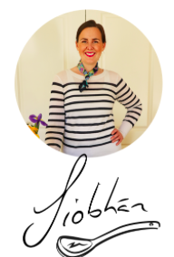
Siobhán Sloane
Background in PR, Sales & Marketing
Moved west to study Ireland's Cultural Heritage
Environmental Education & Tourism Marketing
March 2020 planned to launch Essential Food Trails On-Farm Food Tours east Galway & Burren
April 2020 launched online Farmer's Market Store

Slide 9
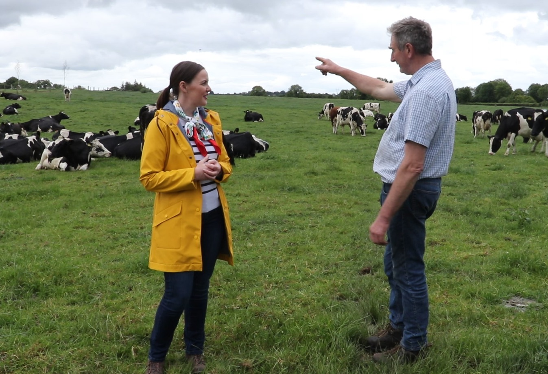
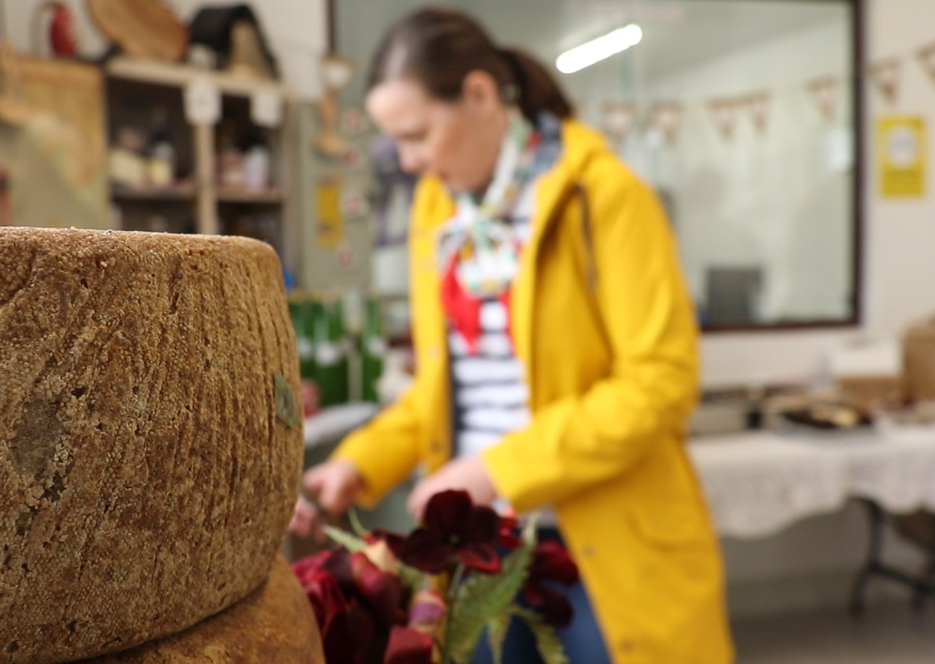
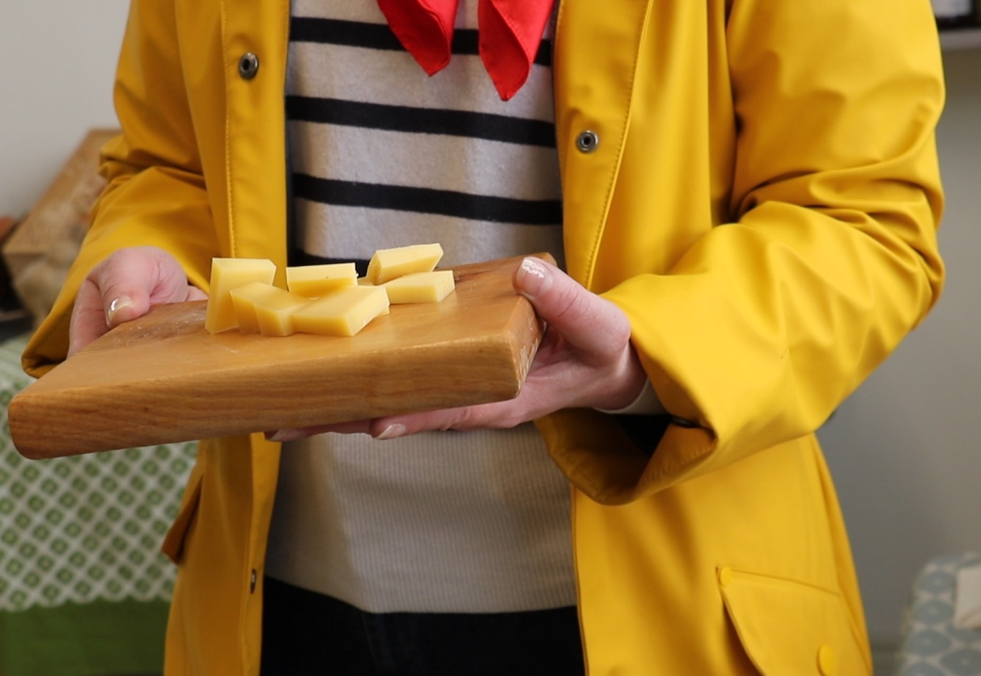
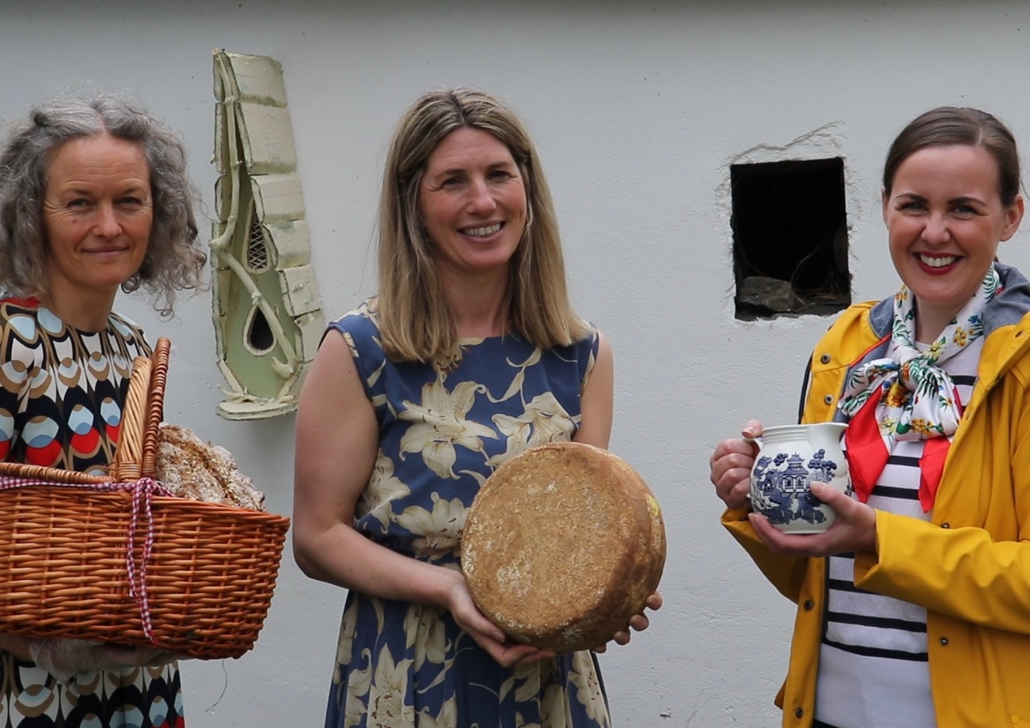
On-Farm Food Tours
Road-trip food tasting tour to farms, markets & restaurants in east Galway & the Burren

Slide 10
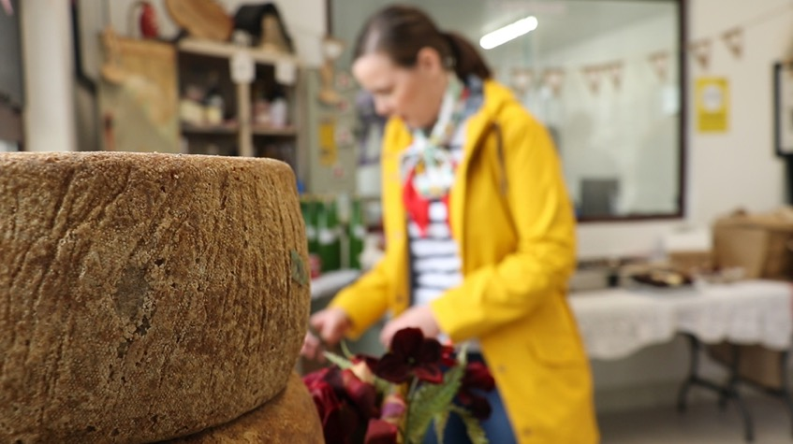
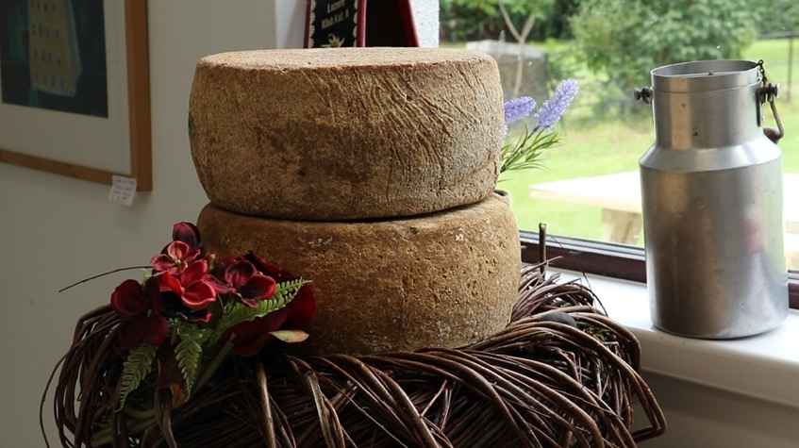
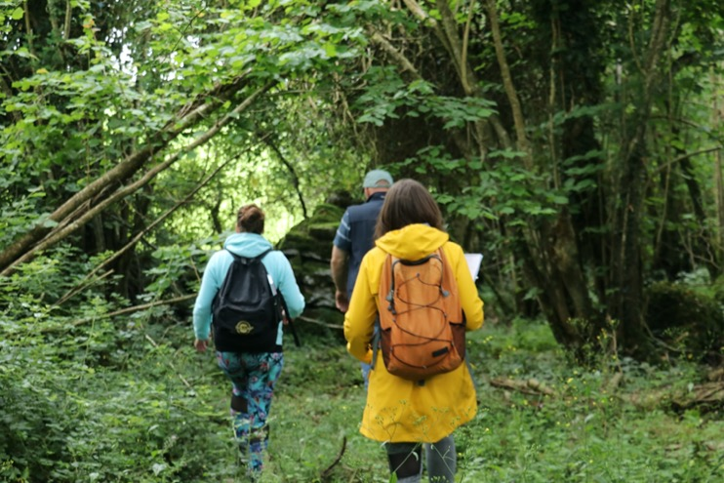
On-Farm Food Tours
Personas:
Overseas travellers to Ireland
Domestic holidaymakers
Chefs
Culinary Arts Students
Pain Points:
Authentic experiences
Fresh air & nature
Wellbeing of producers
Wellbeing of self

Slide 11
Covid-19

Slide 12
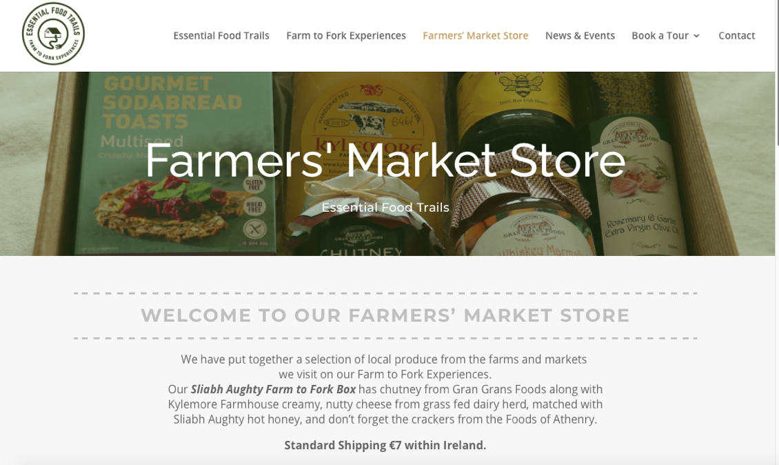
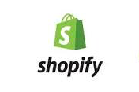
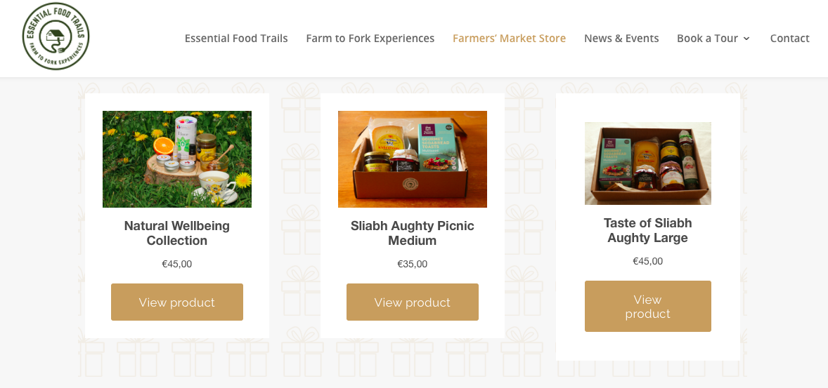
Solution: Set Up Farmer's Market Store with Digital Marketing
E-Commerce:
Set up Shopify & PayPal Accounts
Integrated into existing website

Slide 13
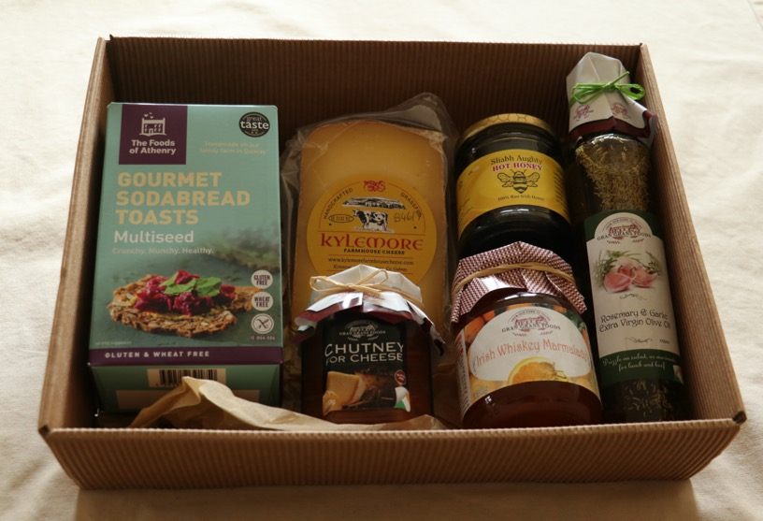
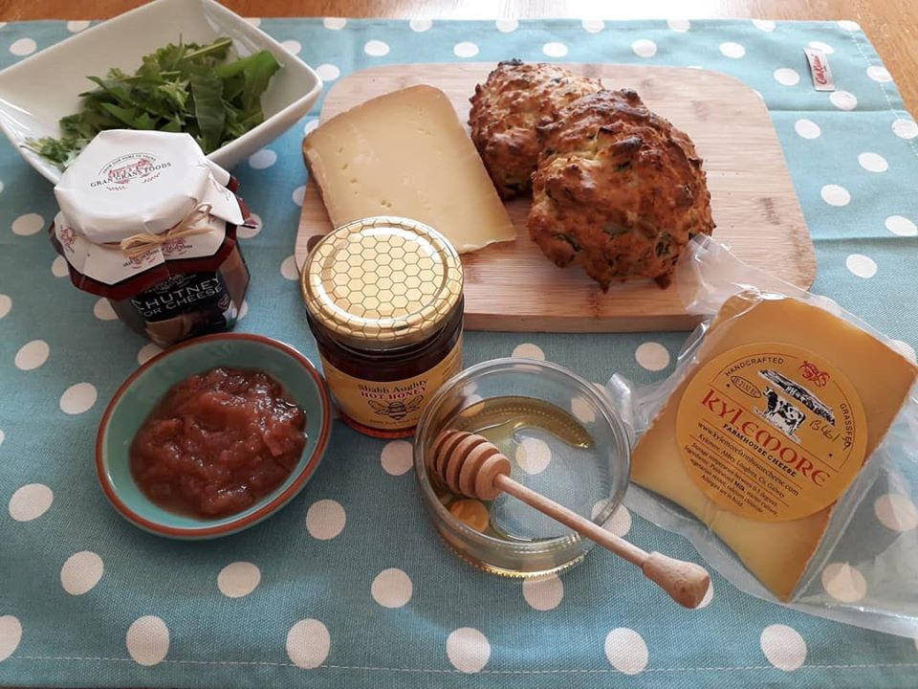
Online Farmer's Market Store – Customers:
Motivations:
Local to the region, want to support small business
Missing visiting Farmer's Markets
Looking for thoughtful gifts delivered to friends & family
How to Reach Them:
Social Media
Traditional Print Media

Slide 14
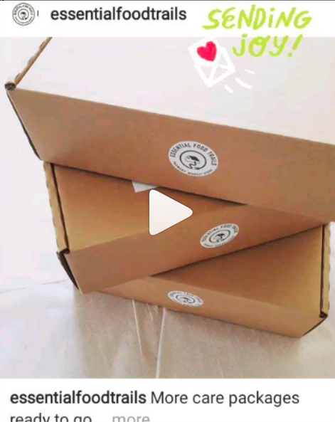
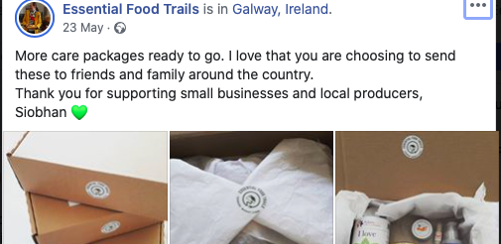
Social Media:
Social Media:
Facebook – posts & ads to connect with customers
Instagram – engaging content to connect with customers
Twitter - to connect with food writers & industry

Slide 15
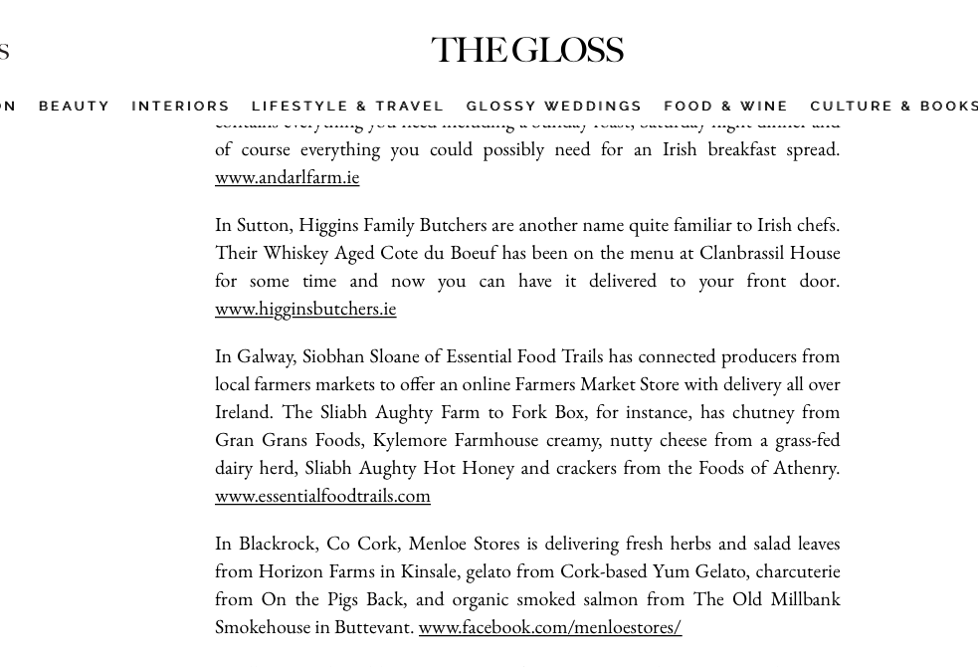
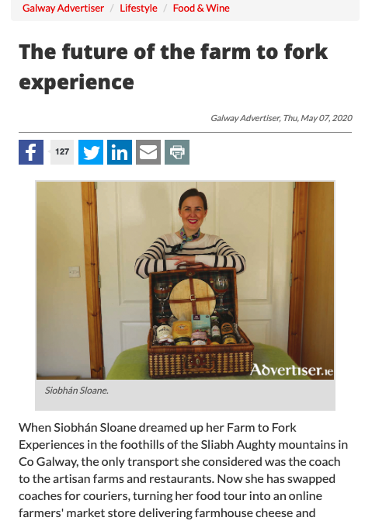
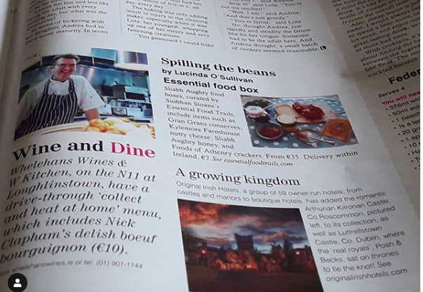
Print Media Coverage Farmer's Market Store

Slide 16
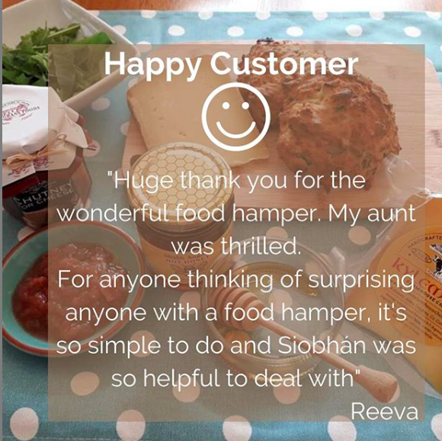
Benefits of Online Farmer's Market Store
Maintain brand awareness
Generate positive publicity
Support producers
Build relationship with producers for future tours

Slide 17
Thank You Siobhán Sloane Essential Food Trails www.essentialfoodtrails.com

Slide 18
What would you like from the final session next week?

