Slide 3
Transforming Channel Program Execution
23rd April 2020
Why sales teams need “Agile Content”
John McArdle
VP Worldwide Sales
john.mcardle@channelmechanics.com

Slide 4
Topics
Why do we need content?
What do we mean by content for modern selling?
How is content used?
How do you get good content?
What tools can you use?
Some examples: Good, Bad & Ugly content (different perspectives)
www.channelmechanics.com

Slide 5
Why do we need content?
Forrester B2B buyer survey reports that..
"62% of B2B buyers say they can now develop SELECTION CRITERIA or FINALIZE A VENDOR LIST based solely on digital content".
GDS RevGen Summit 2019, Netherlands
www.channelmechanics.com

Slide 6
Why do we need “agile” content?
Marketing and Sales alignment can help businesses become 67% better at closing deals……..
But 65% of sales reps say they can't find content to send to prospects... ….
www.channelmechanics.com

Slide 7
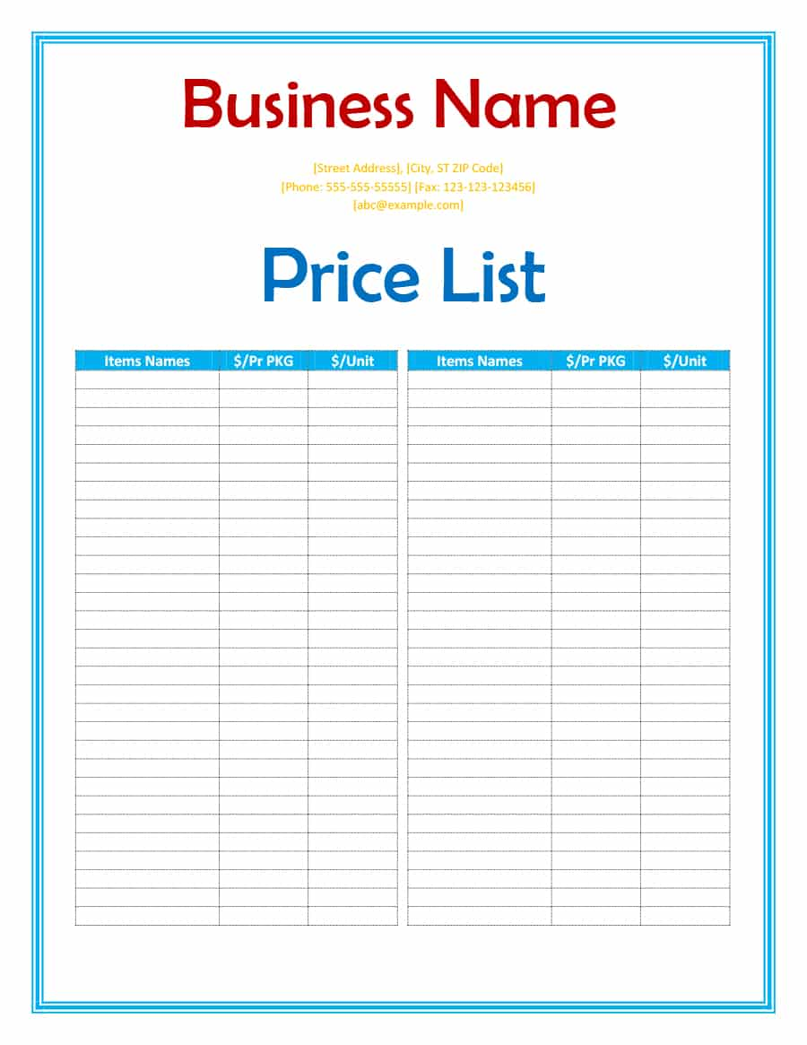
What do we mean by content for modern selling?
www.channelmechanics.com

Slide 8
How is content used?
Buyers perspective
Inform
Educate (learn something new)
Help with decision making
To compare between different vendor offerings
Vendor perspective
Brand awareness (picked up by search engines)
Provide substance for meaningful outreach campaigns
Educate your prospects
Shorten the sales cycle
Make it “easy” for prospects to choose your offerings
www.channelmechanics.com

Slide 9
How do you get good content?
Use professional video production firms or in-house lab
Produce with recognized industry association or Analyst Firm
Co-write with your advocacy customers
Use professional marketing agencies / PR firms
Get a recognized industry guru to write this, ideally with a recognized publishing brand
Build a network of thought-leader authors to write or give talks for you / with your team
www.channelmechanics.com

Slide 10
Bad content
A quick search on LinkedIn would have shown I have no responsibility for Software Development – wrong target.
Personalization a little off culturally
Hi McArdle
When we done our research on you we wanted to reach out and share with you our capabilities in outsourced software development.
From our research we see that your company develops software solutions. Many companies use our services to augment their existing in-house teams. We have extensive software development capabilities across our 5 offices in India – Bangalore, Chennai, Mumbai, Hyderabad and Pune. Our company is also accredited to IS0 27001.
Our specialities include:
Technologies such as Java, .Net, php, SQLserver and platforms such as AWS, Microsoft Azure and Oracle and we specialist in Applications Development and Applications Maintenance for Financial Services and Banking industries.
My colleagues would like to organize a time for a call with you to share the capabilities we offer and to understand the challenges you have with your software development at this time.
Please let me know when would be the most suitable date for you to have a call.
Have a nice day.
BestBDRever
Some basic company research would show that we’re not in this sector
Typo
www.channelmechanics.com

Slide 11
Ugly content
Hi name
As a Channel Executive you know the value to the business that your sales channels and their constituent members bring. You will also be aware of the potential that exists within your business channels for sales growth and the addition of new products and value-added services when these channels are more effectively managed.
MyCompany helps you address the challenge of optimizing your sales channels and potential to drive your business. We provide a cloud-based platform, delivered as a low-cost SaaS model, to help you automate your sales programs. Our solution integrates with your CRM platform and provides the ability to:
Design, deploy, track, evaluate and change sales promotional offers in real-time.
Rapidly execute marketing campaigns, sales promotions and initiatives, globally or locally through all Sales channels, with minimal investment.
Target offers to specific segments of the sales channels and reward brokers based on performance levels.
Provides Master Agents (and brokers if you utilize them) with greater upfront visibility significantly accelerating the time to revenue and ease of doing business.
Deliver sales incentives to Partners that align with the Vendor’s strategic imperatives. Measure and manage program metrics to ensure ROI is achieved and gather business intelligence for future use.
MyCompany’s platform is now used by a variety of small and large companies including Company 1, Company 2, Company 3, Company 4, Company 5, Company 6 and others.
Additional information on our solution can be found at the MyCompany website and via this short video – here.
Please let me know if our Solution is of interest to you and I can arrange a call to provide further details. I look forward to hearing from you and sharing why so many of our customers are using our Solution for their business.
Best regards,
BestSalesPersonEver
It’s too long
It’s all about your company
What benefits did they gain that are relevant to my business?
Yes of course I’ll let you know!
www.channelmechanics.com

Slide 12
What tools can you use?
Use on every piece of content
Use on critical content e.g. website, eBooks, Whitepapers, Case Studies, Blogs, outbound campaign email text
www.channelmechanics.com

Slide 13
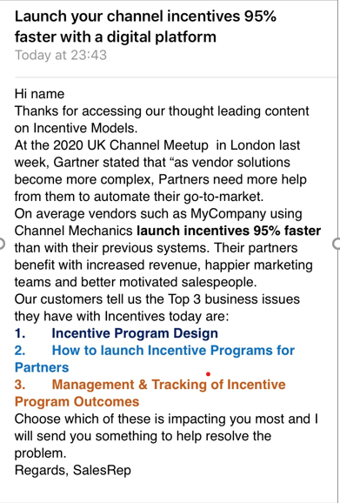
Good content
Attention grabbing headline
Personalized
Relevant to receiver as your marketing has captured a download or websearch on this topic
Timely
Proof of benefits
Renders on 1 mobile screen
Stands out e.g. use of appropriate colours
Has a clear Call To Action (CTA)
Has a strong chance of getting a response
www.channelmechanics.com

Slide 14
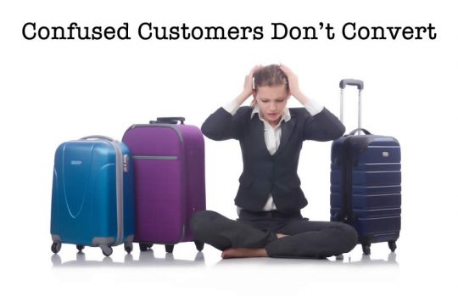
Some tips for your business….
Buyers today are faced with COMPLEXITY OF CHOICE….and usually have too many vendors to evaluate and select from…….
Ensure your content strategy does this for your prospects
Provides meaningful and context sensitive content
Your content is easy to find, easy to access, easy to consume on any device
Makes it “easy” for them to consider buying from you
www.channelmechanics.com

Slide 15
Transforming Channel Program Execution
23rd April 2020
Thank you!

Slide 17
The Four Pillars of Successful Content Writing

Slide 18
Empathy
The Four Pillars
Always keep the business you’re writing for in mind, as well as the users who will later read your description.
As a company, you should always aim to please both parties, service provider and service user through engaging and accurate writing.

Slide 19
Creativity
The Four Pillars
Keep your writing interesting and engaging for both yourself as a writer and your eventual audience. The more engaged you are while writing, the more engaged your audience will be when reading.
The use of descriptive language can take your readers on a journey. Spark your audience’s imagination, and give your reader a taste of their potential experience with each content piece.

Slide 20
Clarity
The Four Pillars
The best type of writing is easy to read. Communicate ideas with descriptive language to engage your audience. Don’t lose them with inaccessible phrasing.
A large block of text can be off-putting for a user browsing through potentially dozens of products and services. The easier and more enjoyable you make their reading experience, the more likely they will be to follow through.

Slide 21
Accuracy
The Four Pillars
Get to know your service provider - what they offer, and what they’re all about - so you convey an accurate depiction of who they are. Make sure that all claims you make are backed up by a source of information provided to you by the company directly.

Slide 22
Skilling Up Your Team for Content Creation

Slide 23
Sourcing and selecting the right skills and personalities
To create the most impactful and high quality content, you require diverse writer/s backgrounds, preferably from an e-comm based platform
Selection process for candidates, 5 stage filter:
Initial recruitment overview for basic qualifications
Written (content creation) assessment
Standard experience verification interview
Team committee interview for cultural fit
Final operational interview and fit assessment

Slide 24
Continuous upskill
To continuously engage and motivate the creative side of content writers, the below exercises can be beneficial:
Content sharing exercises, content creators from different backgrounds create a piece on the same service/product and asses the final product of their peer/s
SEO team/Firm assessment sessions, creators love seeing tangible results of their work, SEO performance, leads and site traffic from their created pieces, kicks up the motivation
Workshops with experienced writers, publishers allows the content creators to assess and confirm their writing skills and quality standards

Slide 25
Perils and Pitfalls of Digital Content Creation
Fergal Lyons
InsideOut Sales and Services
www.insideoutsales.ie

Slide 26
Creating Content – Pitfalls to watch for
Dubious and Irrelevant Claims
Claims Management
Unintentionally Offending
Cultural Considerations
Conflating Audiences
Target your content
Surging content requests
Make sure it will be used
Notes:
Communication is key to ensuring you are creating the right content for the right audience that will be used effectively over and over again by your sales teams

Slide 27
Claims
Nearly Half of Americans Admit to ‘Stalking’ an Ex or Current Partner Online
8 out of 10 cats prefer Whiskas
62% of B2B buyers say they can now FINALIZE A VENDOR LIST based solely on digital content
Dentists recommend brushing twice daily with Colgate
37% of high-growth companies use inside sales as primary sales strategy
Engaged Couples Rely on Technology & Wedding Professionals for All Planning & Partying Needs
AXA - 75% No-claims discount - highest in Ireland!
Notes:
Claims can be about your product or Service. Or they can be about the market, user behaviors

Slide 30
Why do we use Claims in developing content
To create context
To bring credibility
To show relevance
To highlight a pain point
To brag
Applies equally in:
Web site content
Printed materials
Presentations
Email messaging
White papers
Datasheets
Blogs
Podcasts
Etc..

Slide 31
Claims Checklist
Are the claims correct and accurate?
Are they derived from a reliable source?
Are they relevant and representative?
Are they current and up to date?
Are they applicable to your region?
Are there legal concerns?
Risks
Credibility
Legal issues
Competitive Leverage

Slide 32
Recommendations
Review and validate all claims used in content before publication
Ensure all claims are properly attributed with source and date
Choose claims carefully
Use consistently across digital content types
Schedule a review of claims on a regular basis
Pull and revise any content that uses ‘retired’ claims

Slide 33
Tracking Claims
Claim ID | Claim | Source | Region | Date | Date Expires
IO001 | Over the past two years, 46% percent of study participants reported a shift from a field sales model to an inside sales model. | Harvard Business Review | US only | August 2019 | Sept 2020
IO002 | 37% of high-growth companies use inside sales as their primary selling strategy. | Sales Weekly, Jan 2020 | Global | Jan 2020 | Jan 2021
IO003 | According to EY 7 out of 10 medium to large companies in Europe have outsourced at least one business function! | Ernst & Young | Europe | March 2020 | March 2022

Slide 34
Cultural Considerations

Slide 35
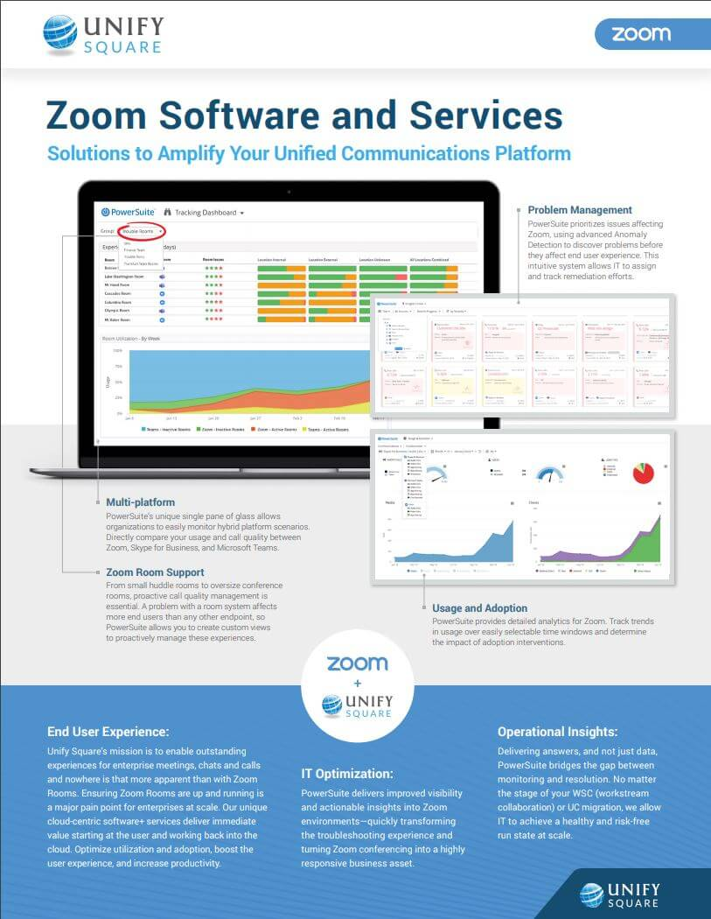
Mind your language
Be sensitive and sensible
Write for as broad an audience as you can
Adapt for your market
Avoid aggressive phrasing
“Dominate your industry”
Avoid colloquialisms
“Come to Galway for the craic”
Ensure accurate translations
Check with local resources if possible

Slide 36
Imagery
Consider your audience
Consider your message
Inclusivity is good
Cultural appropriation is not!
Be sensitive to different standards in different markets
Notes:
People respond better to imagery of people who look like them. Consider modifying imagery based on your market

Slide 37
Creating Content – Pitfalls to watch for
Dubious and Irrelevant Claims
Claims Management
Unintentionally Offending
Cultural Considerations
Conflating Audiences
Target your content
Surging content requests
Make sure it will be used
Notes:
Communication is key to ensuring you are creating the right content for the right audience that will be used effectively over and over again by your sales teams

Slide 38
InsideOut – Building Great Sales Teams
Outsourced Inside Sales to help build reach, scale and talent
Sales resources to add capacity to your sales function.
Flexible resource model to scale up to implement sales initiatives and marketing campaigns
Focussed on Start-ups and SMEs
Local and European markets
Sales Training and Consultancy
Talent development and team development
Notes:
We deploy a flexible resource model to scale up to implement sales initiatives and marketing campaigns
We fully integrate with your business, marketing, existing sales teams, tools & operations
We employ highly motivated, results driven sales professionals focused on selling your products and solutions

Slide 39
THANKS!
Any questions?
You can find me at:
fergal@insideoutsales.ie

Slide 40
Q&A

